Slide 1
OPEC Short-, Medium- and Long-term Energy Outlook
OPEC Secretariat

Slide 2
Outline
Short-term market outlook
  Short-term oil market outlook
  Economy, demand, supply and stock assessments
Medium- and Long-term Market Outlook
  Key assumptions
  Energy outlook
  Oil outlook

Slide 3
World economic growth at 2.7% in 2024 and 2.9% in 2025
GDP percentage change from the previous year, %
The global economy is forecast at 2.7% in 2024 and at 2.9% in 2025, however, uncertainties such as tighter interest rates, geopolitical tensions, etc. remain.

Slide 4
Global oil demand continues to recover in 2024 & 2025 y-o-y change, mb/d
World oil demand is forecast to increase by 2.2 mb/d in 2024 and 1.8 mb/d in 2025.
Note: * 2024-2025 = Forecast. Source: OPEC.

Slide 5
Non-OPEC supply recovery slows in 2024 & 2025 y-o-y change, mb/d
Annual growth for selected countries
y-o-y change, 2024 and 2025
Non-OPEC supply growth
■ 2024/23  2025/24
1.19 mb/d 1.27 mb/d
US liquid production breakdown
 | US liquids | 2023 | 2023/22 | 2024* | 2024/23 | 2025* | 2025/24
 | Tight crude | 8.31 | 0.54 | 8.67 | 0.36 | 9.07 | 0.40
 | Gulf of Mexico crude | 1.88 | 0.15 | 1.91 | 0.03 | 1.98 | 0.07
 | Conventional crude oil | 2.75 | 0.34 | 2.66 | -0.09 | 2.57 | -0.09
 | Total crude | 12.93 | 1.02 | 13.24 | 0.31 | 13.61 | 0.38
 | Unconventional NGLs | 5.30 | 0.52 | 5.54 | 0.24 | 5.76 | 0.22
 | Conventional NGLs | 1.12 | -0.03 | 1.09 | -0.03 | 1.07 | -0.02
 | Total NGLs | 6.42 | 0.49 | 6.63 | 0.21 | 6.83 | 0.20
 | Biofuels + Other liquids | 1.53 | 0.09 | 1.56 | 0.03 | 1.58 | 0.02
 | US total supply | 20.89 | 1.60 | 21.43 | 0.54 | 22.03 | 0.60
Non-OPEC liquids production is forecasted to increase by 1.2 mb/d in 2024 and 1.3 mb/d in 2025.
Note: * 2024-2025 = Forecast.
Sources: EIA, OPEC and Rystad Energy.

Slide 6
OECD stocks declined in December compared to the previous month, while non-OECD increased m-o-m (mb)
Non-OECD
OECD commercial stocks
(deviation from 2015-19 average)
OECD commercial stocks declined m-o-m in December to stand at 2,754 mb, standing 159 mb below the 2015-2019 average –
crude (-86 mb) and products (-73 mb).
Non-OECD stocks increased m-o-m in December to stand at 3,279 mb.
Sources: Euroilstock, IEA, METI, OPEC and EIA.
Sources: OPEC and Energy Intelligence.

Slide 7
Despite improving oil prices, global E&P spending lags historical levels
Global spending is expected to grow at a slower pace in 2023-2025.
Note: 2024 ORB price = Year-to-date.
* Global spending 2024-2025 = Forecast.
Sources: Rystad Energy and OPEC.

Slide 8
Outline
Short-term market outlook
  Short-term oil market outlook
  Economy, demand, supply and stock assessments
Medium- and Long-term Market Outlook
  Key assumptions
  Energy outlook
  Oil outlook

Slide 9
Key assumptions on population growth, demographics and economy underpin the forecast
Global population to rise from 8 billion in 2022 to 9.5 billion in 2045, overwhelmingly driven by non-OECD
Share of working age population to decline from 65% in 2022 to 63% in 2045, while urbanization increases
Global GDP nearly doubles to $269 trillion in 2045 (2017 PPP) from $138 trillion in 2022; growth averages 3% p.a. over the entire forecast period
India remains the fastest growing major economy with an average growth rate of 6.1% p.a.; China sees deceleration on maturing economy and aging population
Long-term annual real GDP growth rates (% p.a.)

Slide 10
Renewed focus on energy security and affordability led to major shifts and delays in energy policy
WOO 2023 takes recent policy developments into account to provide a new, forward thinking, realistic and data-driven outlook.
As such, this outlook takes a relatively cautious approach towards assuming that already-enacted, let alone announced energy policies, will be comprehensively implemented.
Moreover, it critically assesses specific policy targets based on available technology options, cost developments, trends in competition and levels of energy-related investment.
On technology, the WOO assumes a continuous evolution, especially in respect to improved energy efficiency and evolving cost.

Slide 11
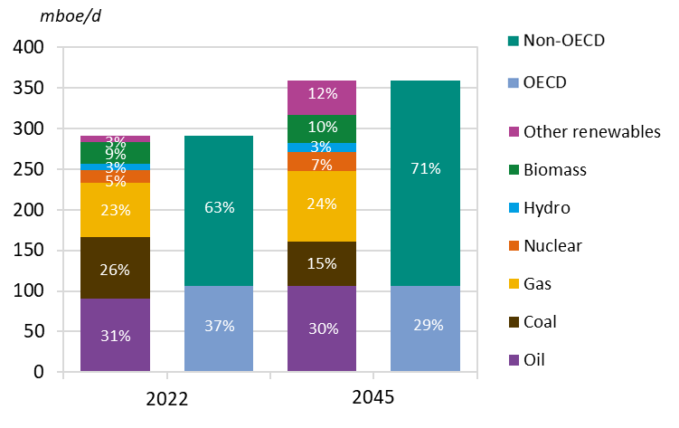
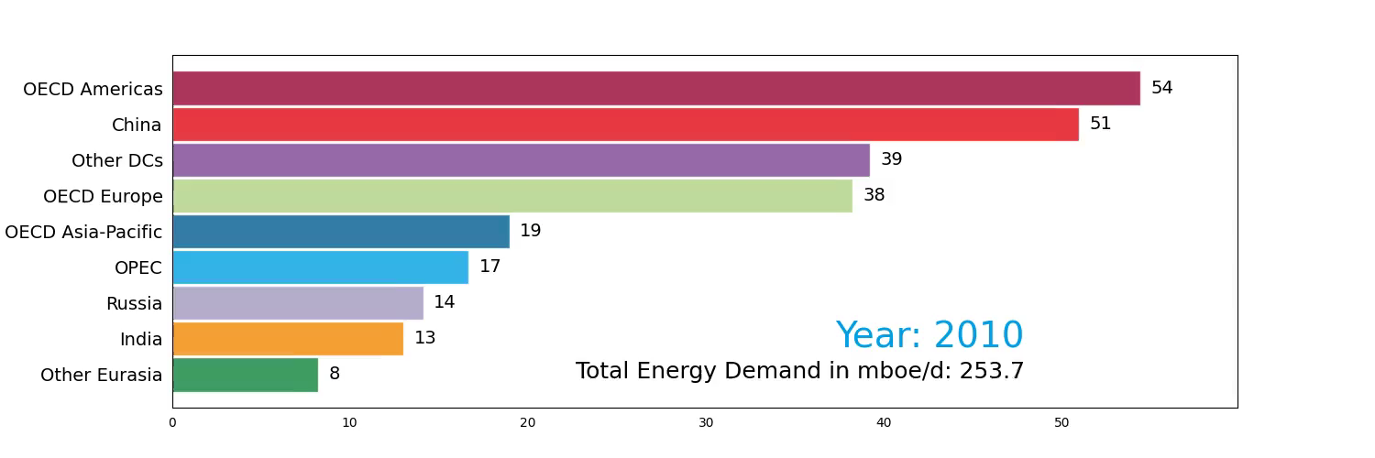
Global primary energy demand is forecast to increase by a 23% in the period to 2045, from 291 to 359 mboe/d
Primary energy demand by fuel
Growth in primary energy demand by region, 2022 -2045
Oil will retain the largest share of the energy mix by 2045
Energy demand is driven exclusively by non-OECD. Its share in the global energy demand increases to 71% in 2045, up from 63% in 2022
India’s demand increasing the fastest, around 3.1% p.a. on average

Slide 12
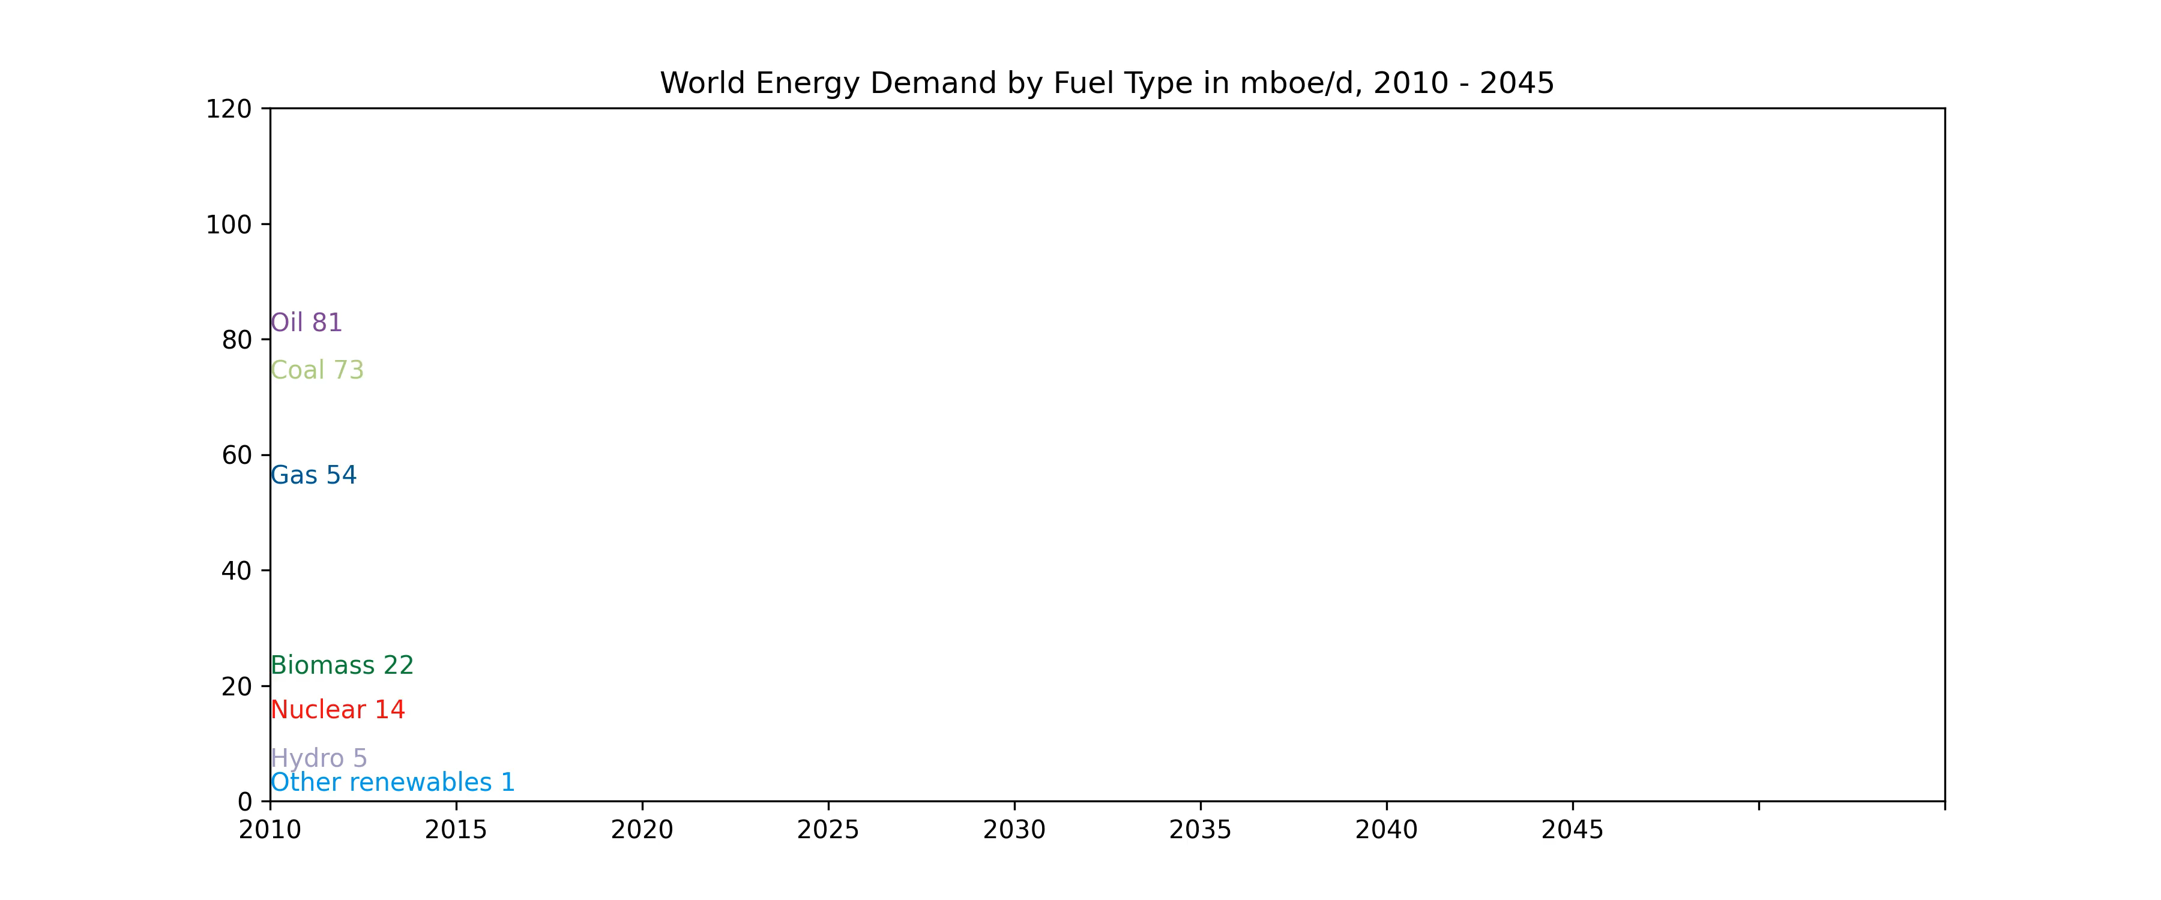
Solar, wind, natural gas and oil lead the growth in primary energy demand growth to 2045
Other renewables, mainly wind and solar, will have the largest and fastest growth, adding 34 mboe/d to 2045
Natural gas shows the second largest growth of 20 mboe/d between 2022 and 2045
Oil gains around 15.4 mboe/d
Coal expected to decrease by 21.5 mboe/d, due to restrictive policies and push for renewables and nuclear in the power generation
Growth in primary energy demand by fuel, 2022-2045

Slide 13
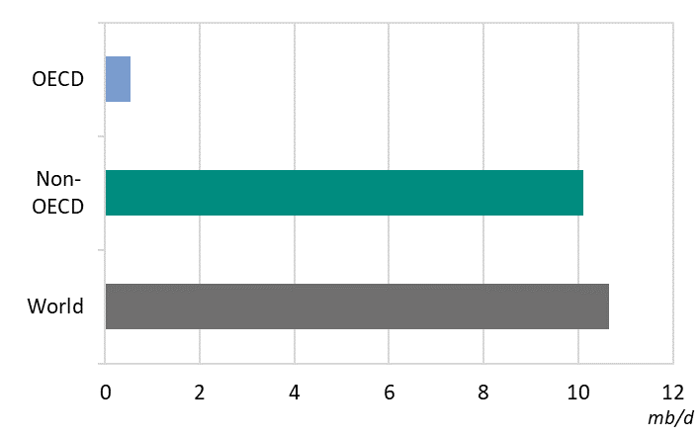
Global oil demand projected to reach 110.2 mb/d by 2028
Following strong growth projected for 2023 and 2024, global demand will increase by 1.5 mb/d p.a. on average over 2025-2028 period
Non-OECD oil demand is projected to increase by a robust 10.1 mb/d between 2022 and 2028
  China leads the growth
  Road transport and petrochemicals provide largest incremental demand
OECD demand shifts to declining towards the end of the medium-term; overall demand increase of 0.5 mb/d by 2028
Global oil demand by 2028 is 10.6 mb/d higher than in 2022
Incremental oil demand by region, 2022-2028

Slide 14
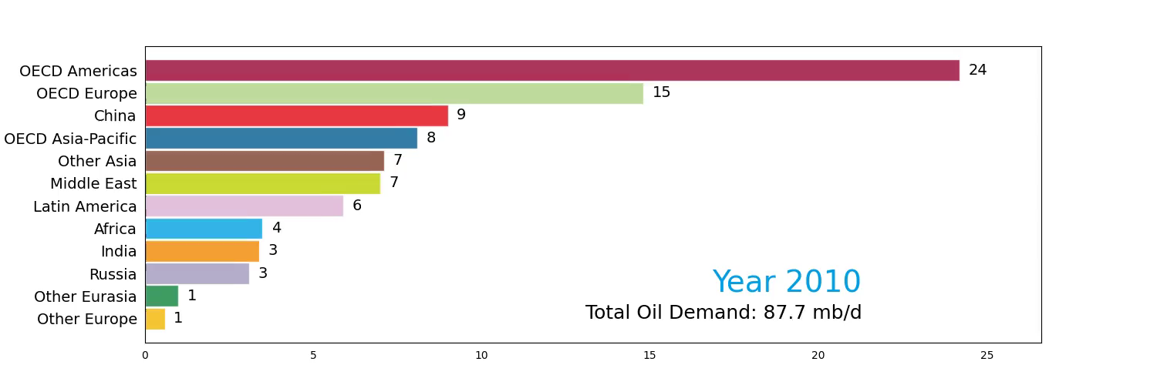
Global oil demand projected to increase by more than 16 mb/d, rising to 116 mb/d in 2045
Long-term oil demand by region, mb/d
Oil demand will continue growing in the long-term
Oil demand projected to reach 116 mb/d in 2045
Growth in non-OECD region (+25.7 mb/d) will be partly offset by declines in the OECD (-9.3 mb/d)
Largest incremental demand in India (6.6 mb/d), Other Asia (4.6 mb/d), China (4 mb/d) and Africa (3.8 mb/d)

Slide 15
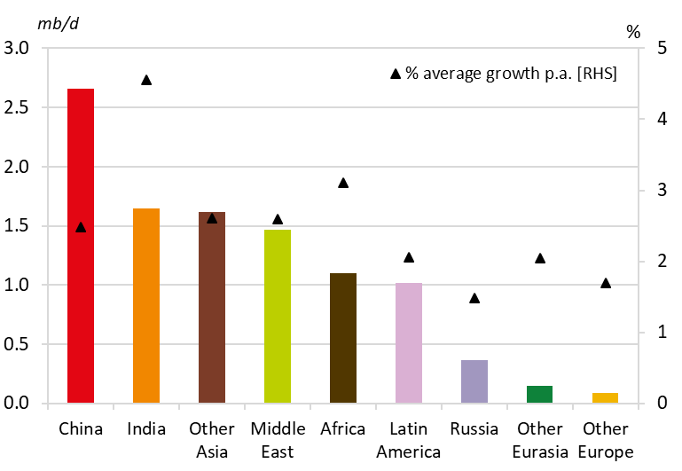
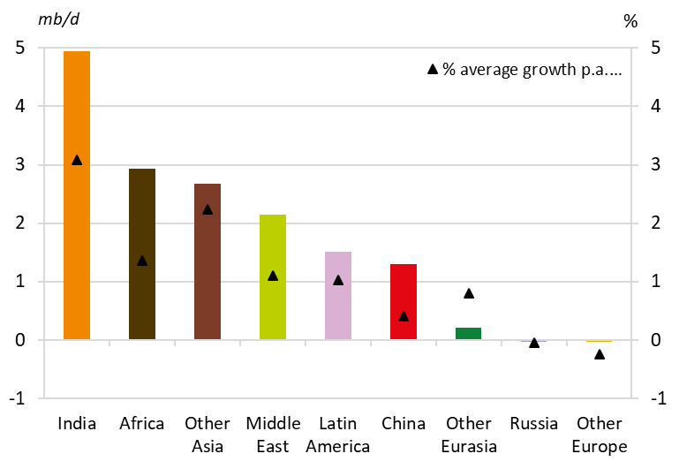
Long-term demand growth will increasingly come from India, Other Asia, Africa and the Middle East
Non-OECD regional oil demand growth
2022-2028
2028-2045
In the medium-term period, demand growth will be driven by China
In the long-term, India will take over the leading role
Significant growth is also projected for Other Asia, Africa and the Middle East due to economic progress, urbanization, industrialization and expansion of the vehicle fleet

Slide 16
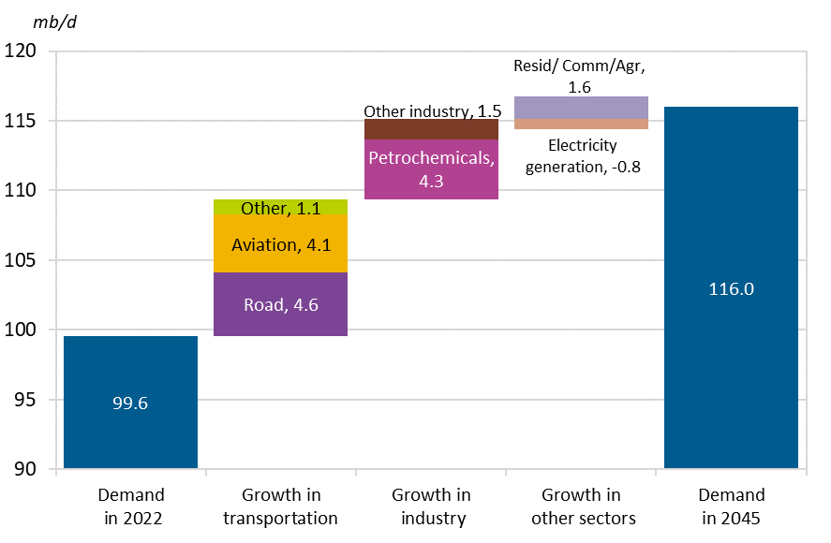
Road transportation, petrochemicals and aviation will drive future oil demand growth
Oil demand growth by sector between 2022 and 2045
Largest contributions to future demand growth:
  Road transportation +4.6 mb/d
  Petrochemicals +4.3 mb/d
  Aviation +4.1 mb/d
Overall demand increase in other sectors (except electricity generation) in the range of 1 mb/d to 1.6 mb/d
Electricity generation: demand decline of 0.8 mb/d between 2022 and 2045

Slide 17
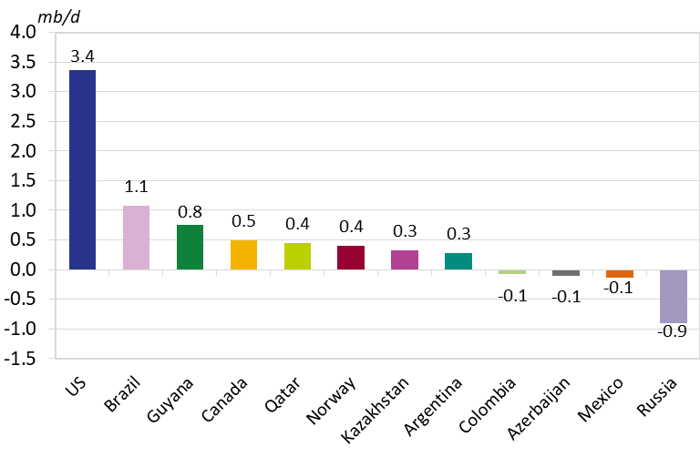
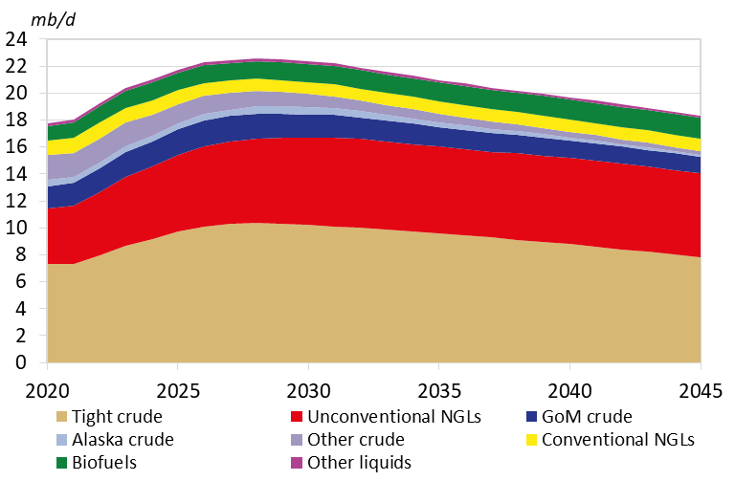
Non-OPEC liquids supply sees strong medium-term growth, before peaking in early 2030s
Select contributors to non-OPEC total liquids change 2022-2028
US total liquids supply outlook
Non-OPEC liquids supply projected to grow from 65.8 mb/d in 2022, to 72.7 mb/d in 2028, or by 7 mb/d
The US makes up nearly 50% of this growth, with strong contributions from Brazil, Guyana and others
But US supply plateauing at 22 mb/d in the second half of the 2020s, leads to a peak in total non-OPEC liquids from early 2030s

Slide 18
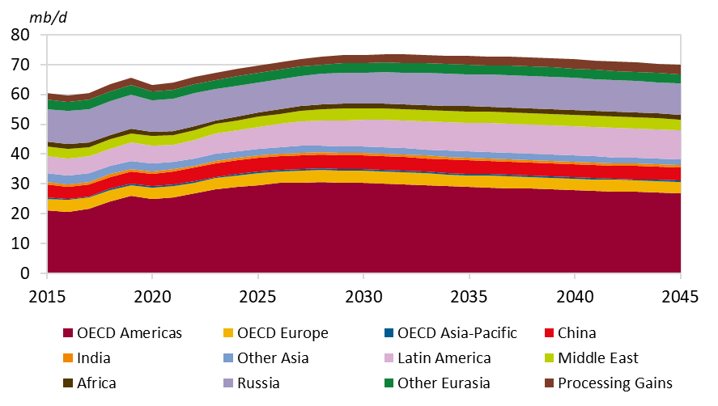
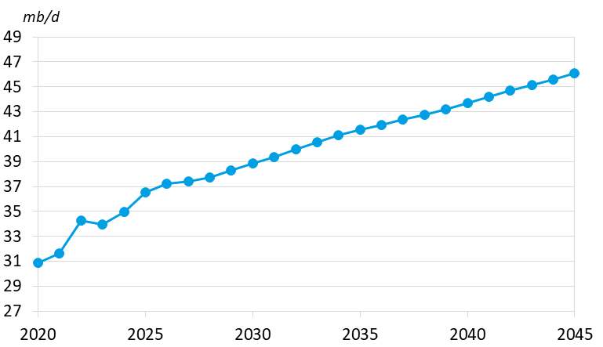
In the long-term, OPEC supply to play growing role
Long-term non-OPEC liquids supply outlook
OPEC total liquids supply
Overall non-OPEC production will decline from the early 2030s, falling to 69.9 mb/d again by 2045
Guyana, Canada, Brazil and Argentina set to continue growth beyond the medium-term
As a result, OPEC liquids rise steadily from 34.2 mb/d in 2022 to 46.1 mb/d by 2045, and thus OPEC’s share of global liquids supply increases from 34% in 2022 to 40% in 2045

Slide 19
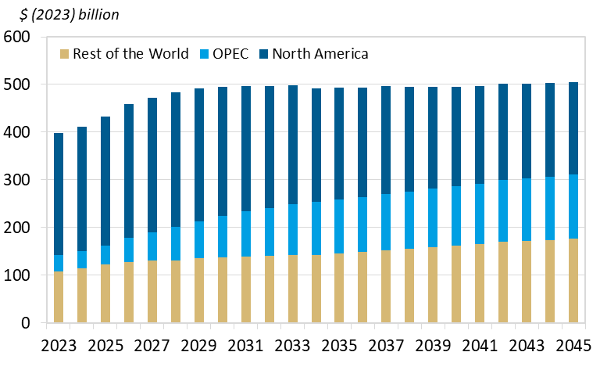
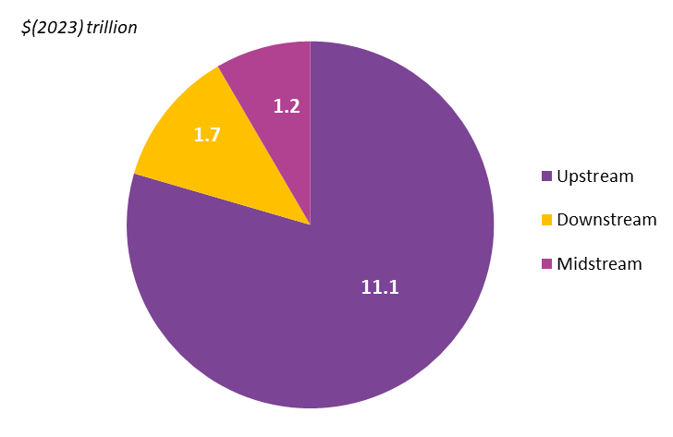
Investment needs to be sustained
Cumulative oil-related investment requirements by sector, 2023-2045
Annual upstream investment requirements, 2023-2045
Investment requirements to sustain oil supplies are estimated at a cumulative $14 trillion in the long-term (in 2023 $US), or $610 billion p.a. on average.
Of this, $11.1 trillion is required in the upstream, or an average of $480 billion per annum – a considerable challenge. Downstream and midstream requirements are $1.7 and $1.2 trillion respectively.

Slide 20
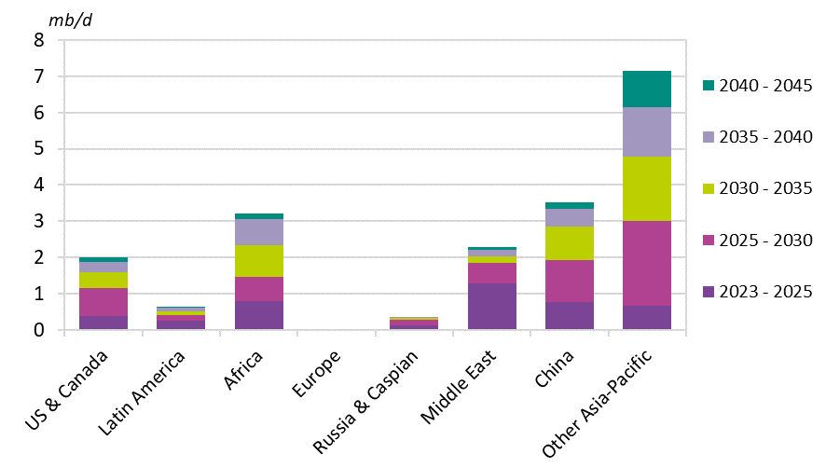
Long-term refining capacity additions expected at 19.2 mb/d
Distillation capacity additions,
2023–2045
Long-term global refinery additions of 19.2 mb/d, reflecting demand growth in developing regions
Required capacity additions in the Middle East, Asia-Pacific and Africa at 16.2 mb/d, accounting for 84% of the total expected additions to 2045
Additions are front-loaded in line with oil demand growth. Expected additions of 1.4 mb/d p.a. in the period to 2025 to decline to 0.3 mb/d p.a. between 2040 and 2045

Slide 21
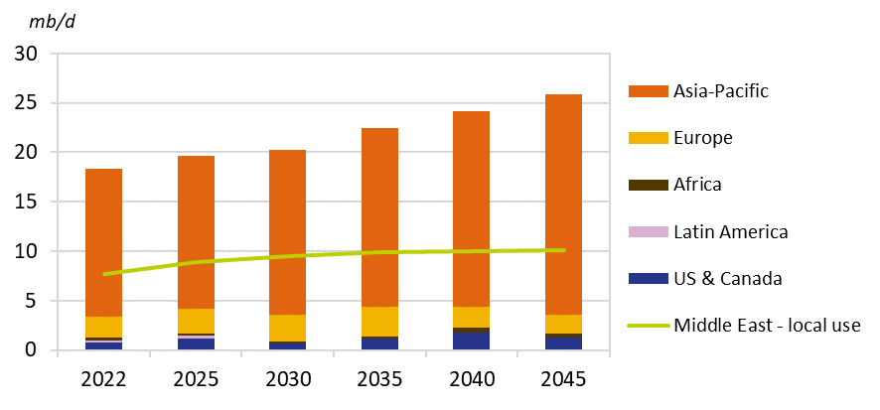
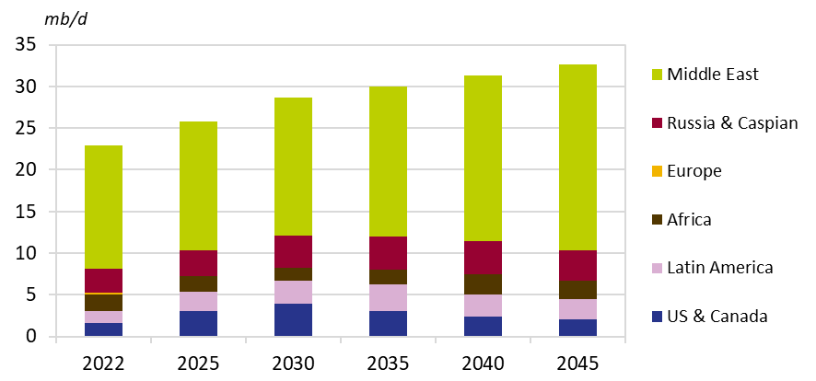
Global crude and condensate trade going strongly from 36 mb/d in 2022 to 45.3 mb/d in 2045
Crude and condensate exports from the Middle East by destination, 2022–2045
Crude and condensate imports to Asia-Pacific by origin, 2022–2045
Middle East is the major contributor to the global trade growth, with volumes increasing from 18.3 mb/d in 2022 to 26 mb/d in 2045
Asia-Pacific remains the most important destination with total imports increasing from 23 mb/d in 2022 to 32.6 mb/d in 2045

Slide 22
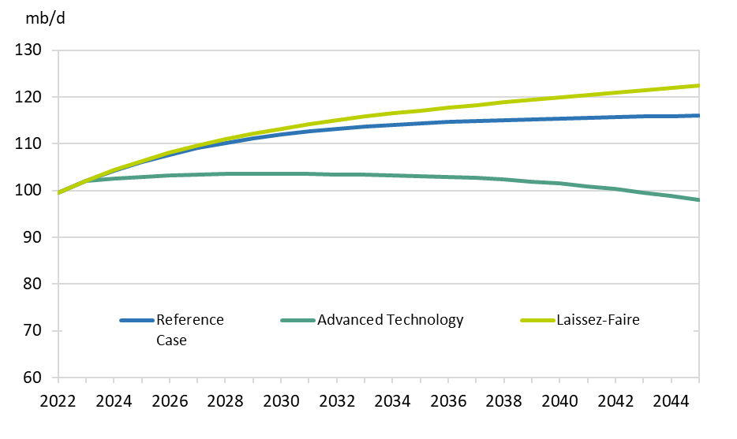
Two alternative scenarios were developed
Advanced Technology Scenario
Oil demand will stabilize at levels above 100 mb/d in the period to around 2035
Demand starts slowly declining towards 98 mb/d over 2035-2045 period
Laissez-Faire Scenario
Oil demand projected to move consistently above the RC levels
Oil demand will bypass the 112 mb/d mark by 2030 and continue growing to 122 mb/d in 2045
A difference of more than 6 mb/d in 2045 compared to the RC
Global oil demand in the Reference Case and in alternative scenarios

Slide 23
Key takeaways
This year’s World Oil Outlook has re-evaluated energy policies in light of a renewed focus on energy security and affordability
Global primary energy demand is set to expand by a significant 23% in the period to 2045
Global oil demand is set to increase to 116 mb/d in 2045 and will retain the largest share in the energy mix at almost 30%
With rising oil demand and non-OPEC liquids supply peaking in the early 2030s, OPEC’s share in the overall global liquids base increases from 34% in 2022 to 40% in 2045
Cumulative investment of $14 trillion in oil is required through to 2045, meaning all stakeholders need to work together to ensure a long-term investment-friendly climate that works for both producers and consumers
A sustainable energy future for all needs to focus on an inclusive ‘all-peoples, all-fuels and all-technologies’ approach

Slide 24




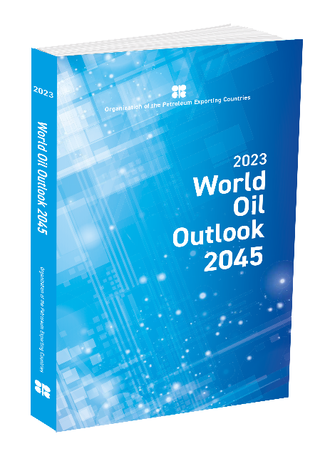

Available as:
Book
Interactive version
Smart app

