Slide 1
Competing for Capital:
Rebuilding Confidence in Global
Energy Investment, Clean Competitiveness,
and Resilience
Industry Advisory Council Meeting, International Energy Forum
3 Feburary 2026
Yoshikazu Kobayashi, Ph.D
The Institute of Energy Economics, Japan (IEEJ)

Slide 2
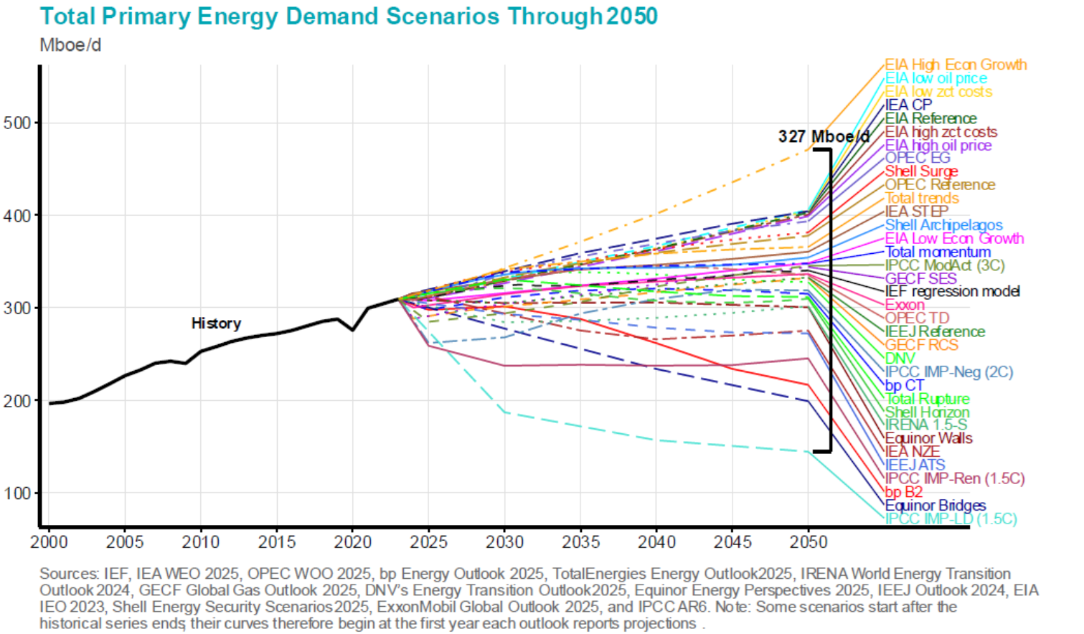
Session questions
Which of these scenarios will set the tone for policy makers and energy investors going forward?
Can investors and innovators make confident decisions under these levels of “uncertainty”?
How should IEF members and IAC stakeholders act (to promote investments in hydrogen and CCUS) ?

Slide 3
Different scenario, different approach
Note the difference of methodologies for each scenario’s development.
Both government and industry should use the forecast scenario to set ambitious goals, and the backcast scenario to track and benchmark progress.
Forecasting approach
Backcasting approach
?
Desired future
Current status
?
Time
Time

Slide 4
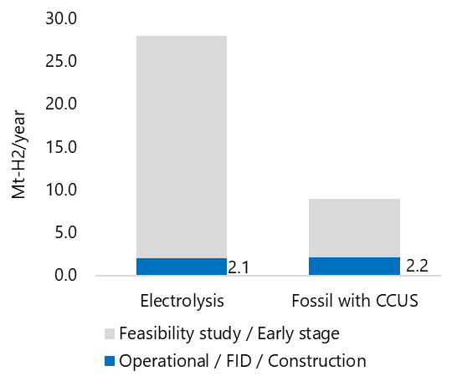
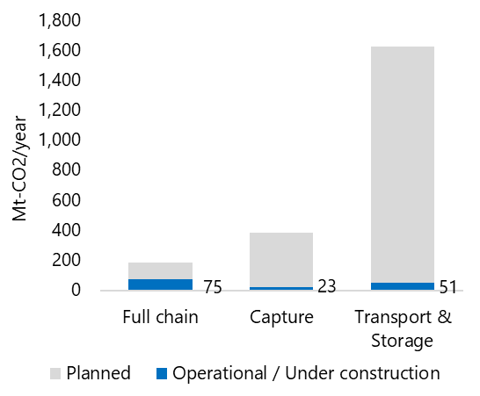
How far should we go, or how far have we come?
The summed planned capacity seems too large to materialize in practice.
Bottom-up thinking may be more relevant for emerging decarbonization means.
Planned and operating capacity of hydrogen (left) and CCS (right)

Slide 5
Actions for IEF members and IAC stakeholders for H₂/CCS
Clear vision for the future
Credible policy signal with concrete public support
International commitments for emissions reduction
Draw a pathway for commercialization
Identification of appropriate policy tools and duration
Clarification of sectors that are better positioned to manage incremental costs
Market intervention with exit strategy
Policy tools: CfD, grant, regulation, tax benefit, etc.
Exit from support: Support provided for a defined period, with mandatory requirements for continued production
Demand creation
Sharing incremental costs among society

