Slide 1
Public sector commitments to clean energy growth and implementation of technologies: CCS and hydrogen
Japan Organization for Metals and Energy Security (JOGMEC)
Senior Councilor, Chief Technical Officer
YAMAMOTO Koji (Ph. D)
February 3, 2026
Presented at SESSION 2: Full-Spectrum Innovation: Delivering Clean Energy Growth in Diverse Market Settings, Industry Advisory Council Meeting, IEF

Slide 2
JOGMEC - Who We Are, and Japanese Energy Transition Process
Japan Organization For Metals and Energy Security (JOGMEC)
Policy executing agency to affordable energy and metal supply to Japan through the industry
Funding from the Ministry of Economy, Trade and Industry
Area to work: Oil and Gas E&P and LNG, Coal and Minerals, Stockpiling of oil, LPG and critical minerals, Geothermal + CCS, ++++ CCS, H2+NH3, Offshore wind (2022)
Tools for support:
Finance: equity capital and liability guarantee)
Technology: Geophysical survey, R&D, implementation of technologies to industry (high TRL to overpass the death valley), training
Intelligence for Policy/Strategy and International Cooperation: Information to government and industry, interconnecting people, countries, human resource development
NDC of Japan; 2050 Carbon Neutral: Lowering carbon footprint of energy industry:
Decarbonization of fossil fuel: CCS and methane management
Low carbon fuels: clean (low carbon intensity) H2 and NH3, E-fuels
Renewables: supporting private initiative through exploration and subsidy
Current role of us: Bridge to the mature market era when decarbonization has economic value ( ETS/carbon pricing etc.) through pilot projects
Notes:
JOGMEC機能の説明 テンプレート資料

Slide 3
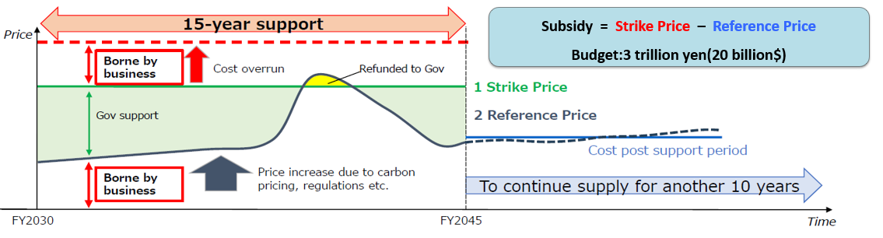

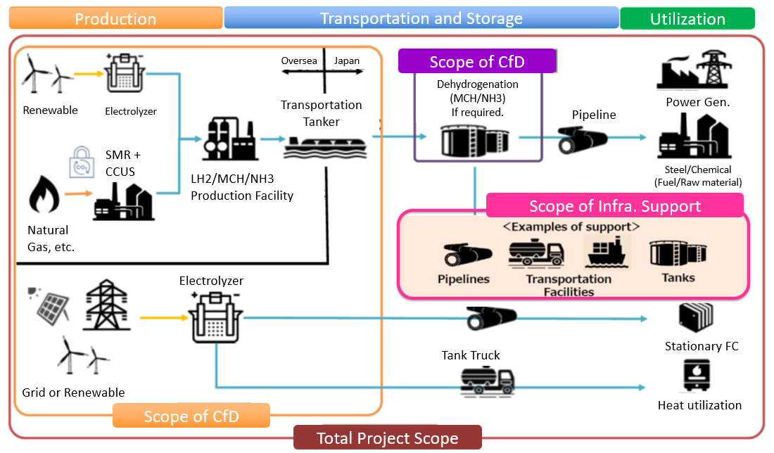
Government Supports to Hydrogen and Ammonia, Roles of us and Beyond
Bridge to the mature market era when decarbonization has economic value ( ETS/carbon pricing etc.)
Generating “first movers”
Piloting and verifying ”total value chain,” technologies and systems
Start from CfD (upstream - OPEX) + Infrastructure support (downstream)
20 billion USD from GX fund
4 projects have already been chosen
Long-Term Decarbonization Power Source Auction (LTDA) for power sector - CAPEX
Creating supportive international business environments
Safety measures, regulations
Clean hydrogen certification criteria
They are made under international collaboration and coordination
CO2

Slide 4
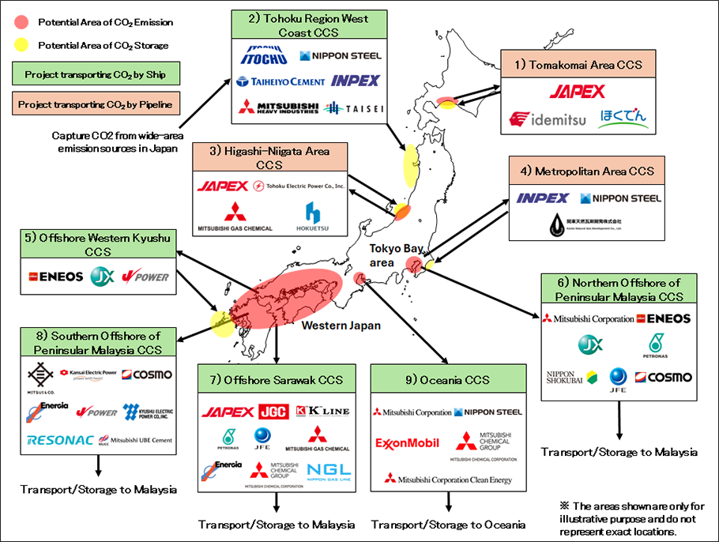
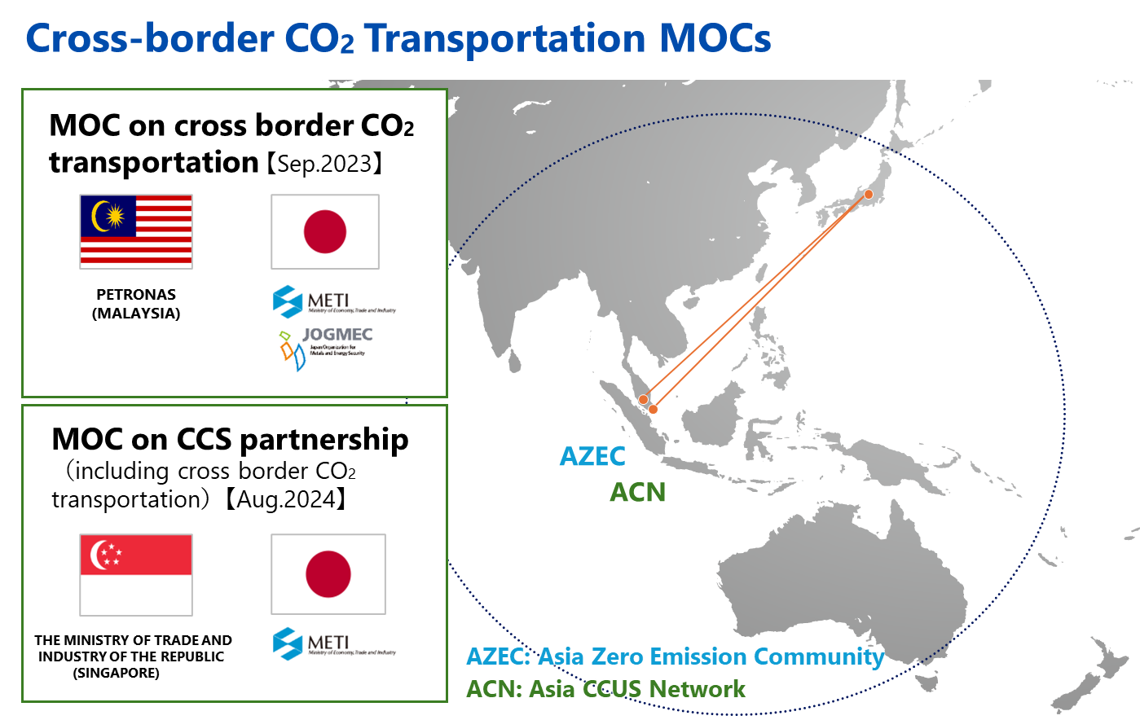
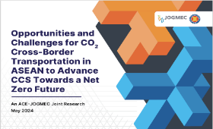

Government Supports to CCS, Roles of us and Beyond
Bridge to the mature market era when decarbonization has economic value ( ETS/carbon pricing etc.)
Exploration and small-scale demonstrations
Joint exploration with Vietnam, Thailand etc.
Hydrogen park in Niigata
Joint CO2EOR+CCS projects in Indonesia
Piloting and verifying ”total value chain”
Advanced CCS projects; commercial scale pilot
Governmental funding until FID followed by CfD type support
Creating supportive international business environments
CO2 cross boundary transportation legal frame to meet London protocol
Ship transport standardization
Safety regulation including induced seismicity and research on monitoring technologies
ADVANCED CCS Projects
9 projects
Combination of CO2 emitters and transportation and storage service providers
Variety of features
Domestic storage vs. oversea storage
Pipeline vs. ship transport
Collaboration with AC Collaboration with ACE
Collaboration with ACE
(ASEAN Center for Energy):(ASEAN Center for Energy): E
(ASEAN Center for Energy):
Joint report on cross-border CO2 transportation
【May 2024】 Collaboration with ACE (ASEAN Center for Energy):

