Slide 1
Industry Advisory Council Meeting
(Session 3) Critical Minerals: The New Foundations for a Clean Resilient and Competitive Global Energy System
test
Insights from the Recent Report
Ali Alsamawi, Senior Energy Analyst

Slide 2
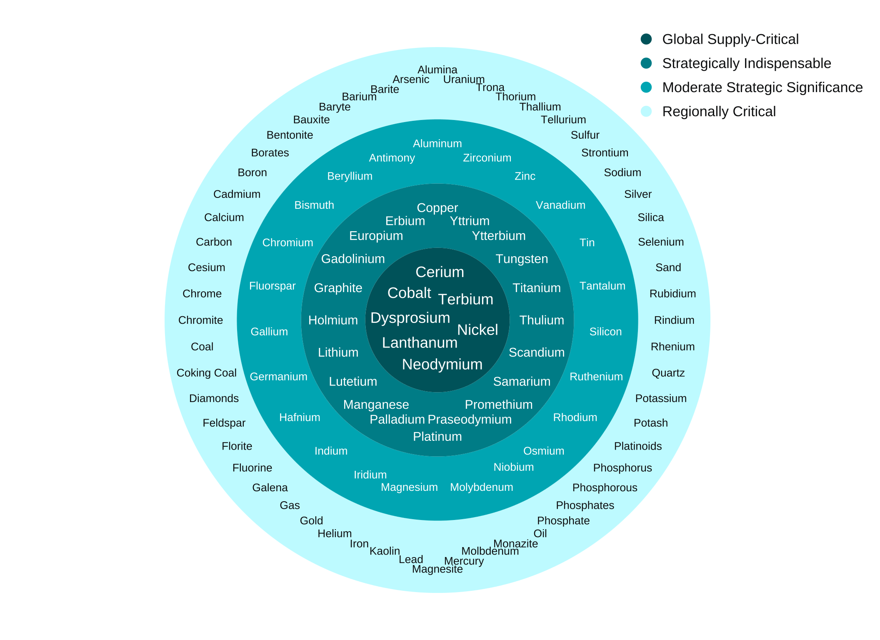
Strategic Importance of Critical Minerals Differs Across Countries
The term “critical minerals” is widely used by policymakers and the media; however, its definition varies across countries.
Minerals classified as ‘global supply-critical’, for example, appear across all national critical minerals lists collected.
The United States, for example, designates 60 minerals as critical, while the EU lists 54 and China 40.
These minerals are considered
critical by all countries
Sources: IEF and national Critical Mineral lists.

Slide 3
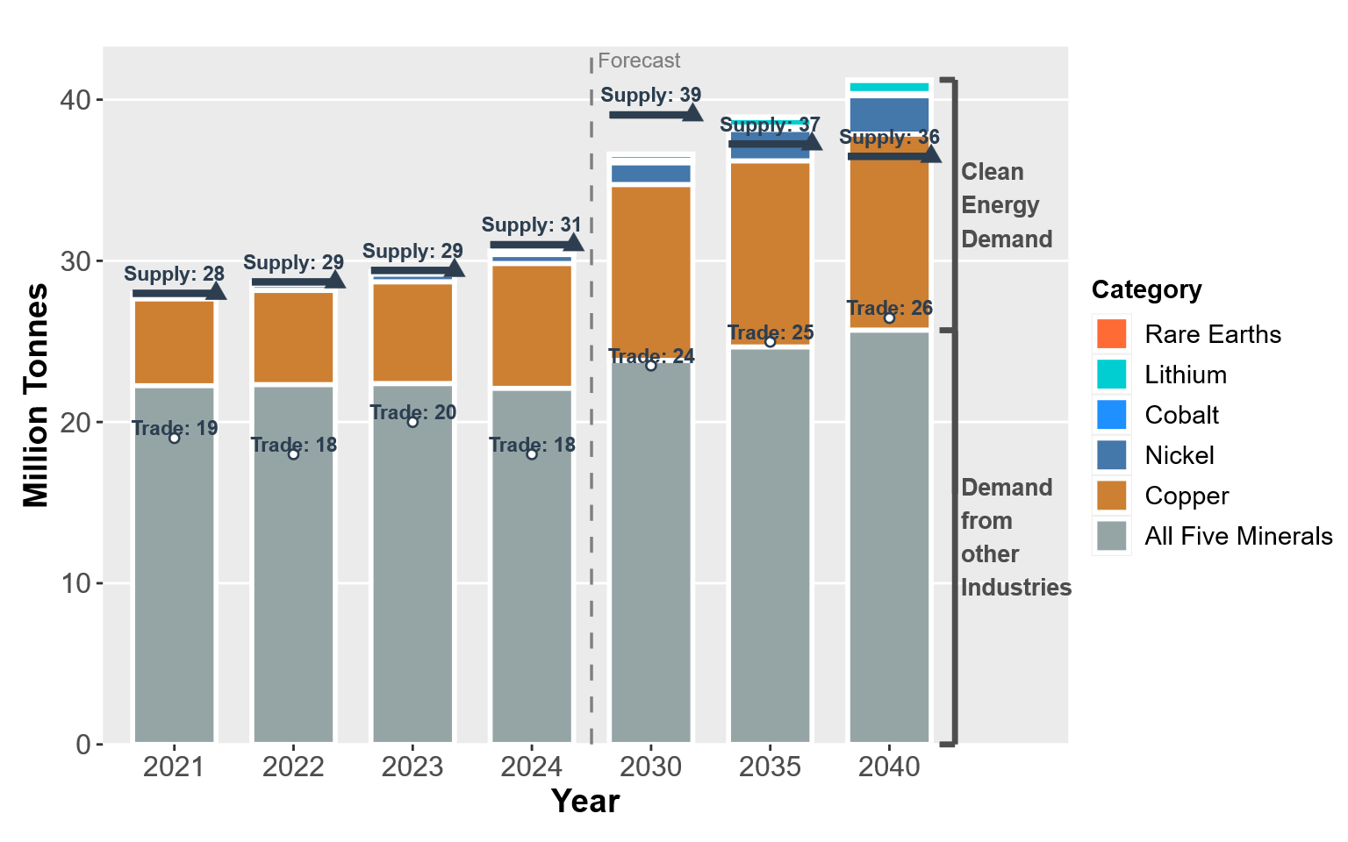
Without Trade and Investment, Supply for Key Critical Minerals May Fall Short of Demand in Less than a Decade
Demand for five key critical minerals continue to accelerate, driven by the material requirements of the global energy transition.
Total demand increases from roughly 28 Mega tonne (Mt) in 2021 to nearly 41 Mt by 2040.
More than 60% of global demand for these materials is traded across borders, highlighting the deep interdependence of producing and consuming regions.
Source: IEF estimations, IEA, UN Comtrade and US Geological Survey.

Slide 4
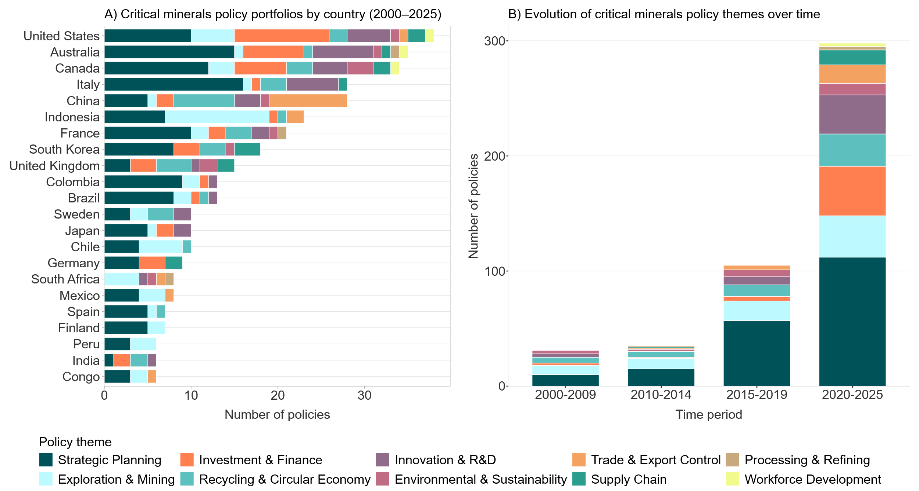
Policies Introduced in 2020–2025 Nearly Double Those of the Previous Two Decades
Source: IEF, IEA and national sources.

Slide 5
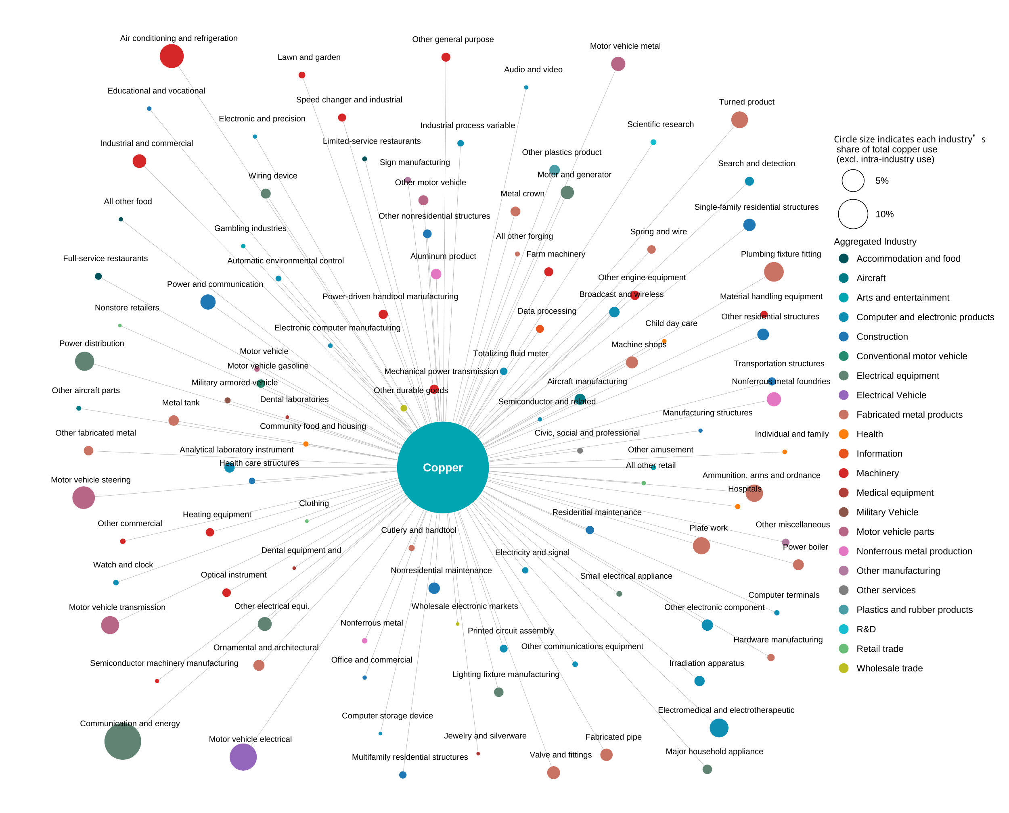
Overview of Copper Use Across US Industrial Sectors
Copper is directly used by more than one hundred industries across the US economy.
This number might roughly double once indirect upstream and downstream linkages are considered.
Electrical equipment accounts for about 26% of total intermediate copper inputs, while motor-vehicle electrical systems make up more than 12%.
Source: IEF estimates derived from the US detailed sectoral production–consumption input–output accounts.

Slide 6
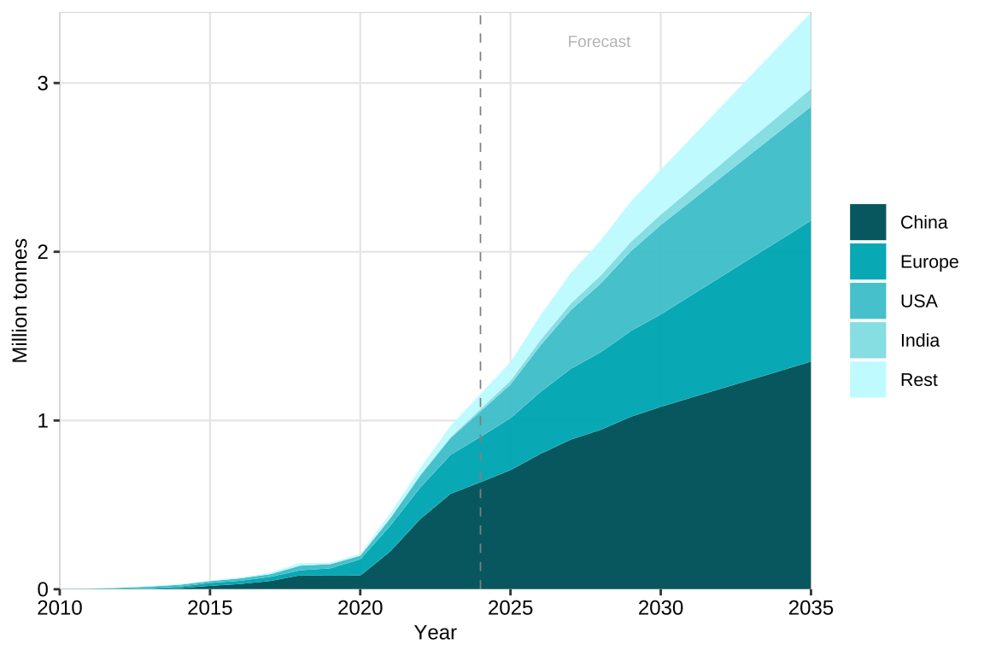
Growth in Copper Demand from Electric Vehicles Is Expanding Exponentially
Copper demand from Electric Vehicles rises from ~0.2 million tonnes in 2020 to ~2.5 million tonnes in 2030 and ~3.4 million tonnes in 2035.
This represents less than 0.01% of global supply in 2020 but expands to 7% by 2030 and 11% by 2035.
Electric vehicles contain, on average, nearly four times more copper than conventional cars.
Source: IEF, British Geological Survey, IEA and Benchmark Minerals Intelligence.

Slide 7
Pathways for Countries to Build or Upgrade Critical Minerals Sectors (Future Work)
Given the importance of critical minerals for energy security and market stability, and prevailing co-dependencies, the IEF will continue to support producer–consumer dialogue by providing member countries and stakeholders with more analysis.
IEF Producer and consumer countries must engage in more inclusive dialogue on critical minerals market functioning to enhance market transparency, reinforce market principles, including non-discriminatory treatment of investors, and reciprocity to avoid entrenching hurdles to the detriment of all stakeholders.
Future work will focus on pathways to help countries strengthen supply-chain resilience by developing new production streams or upgrading existing ones, while prioritizing mineral production based on national needs and comparative advantages. The report will among others focus on:
  Enhancing data transparency and market reporting.
  Estimating value addition across the full value chain, beyond exploration.
  Balancing domestic needs with supply-demand opportunities.
  Identifying human-capital and skills requirements.
  Building critical minerals enabled industries competitively.

Slide 8
Thank You

