Slide 1

Critical Minerals: The New Foundations for a Clean Resilient and Competitive Global Energy System
Digital Infrastructure as a New Pillar of Critical Minerals Supply Security
IEF Industry Advisory Council Meeting
Presented by
Ayla Majid
CEO & Founder
Planetive
February 2026

Slide 2
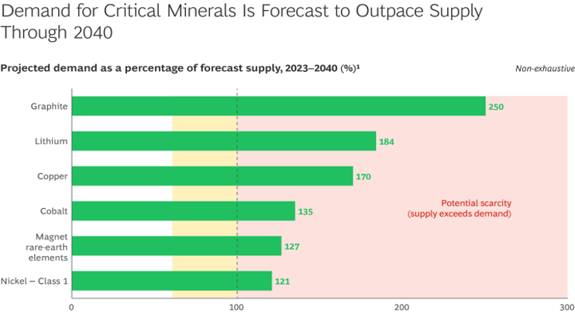
From Demand to Deliverability: The Real Constraint in Critical Minerals
Structural Risks in Global Critical Minerals Supply Chains
By 2030–2040, critical minerals demand is projected to exceed existing supply by 20% to over 150%, depending on the material.
Upstream Weakness = Downstream vulnerability
New mining and processing projects require 7–10+ years to reach production
Exploration & Mining
Refining & Separation
Concentration & Beneficiation
Battery material Production/ Alloying
Manufacturing
Recycling & Circular loops
Long lead times, Geopolitical barriers
ESG issues, radioactive tailings, financing challenges
China refines 90% of rare earths and 60–95% of key battery materials highlighting extreme midstream concentration
China Dominance, Limited Global refining
Without local or allied refining capacity, even well-governed mines fail to translate into energy security
Technology bottlenecks, Cost volatility
Demand Supply Imbalances
Source:BCG (2026), Why ecosystems matter in critical mineral supply chains
Supply is constrained by deliverability: permitting, refining capacity, geopolitics, and social license.
Without governance-aligned Frameworks, shortages become structural
?
Source & analysis: Planetive
Current announcements cover only 50 % of needed investment
US$180–270 bn investment gap by 2030.

Slide 3



Bankable Investment Model For Critical Minerals
Blended Finance + Long-Term Offtake (Producer – Consumer Anchored)
Long-Term Offtake Agreements
Public or Quasi-Public Capital
Private Capital
Revenue Certainty
Risk
Absorption
Market
Certainty
Risk Allocation = Increased FID
Global examples showcasing success
Long term offtake
Predictable cashflows
Digitization
Structured finance
Scalable finance
Project | Mineral | Region | Approx. Capacity / Scale | Offtake Anchor | Relevancy
Vulcan Energy – Lionheart | Lithium (LiOH) | Germany (EU) | 24,000 tpa LiOH (Phase 1) | Stellantis, VW-linked OEM demand | Demand-anchored project unlocked blended public + private capital
Arafura Rare Earths – Nolans | NdPr oxide | Australia | 4,400 tpa NdPr oxide | Hyundai/Kia, Siemens Gamesa | Long-term industrial buyers de-risked financing
Syrah Resources – Vidalia AAM | Graphite (AAM) | USA | 11,250 tpa AAM (initial) | LG Energy Solution | Policy-backed loan + binding OEM offtake
Source & analysis: Planetive

Slide 4




Digital Infrastructure as a New Pillar of Critical Minerals Supply Security
AI – Supply Intelligence
Tokenization – Capital mobilization
Blockchain – traceability Infrastructure
London Metal Exchange (LME) — Digital Warehouse Receipts
De Risking upstream supply at scope
KO Bold Metals (Copper & Battery Minerals
Digital inventory as collateral for trade & project finance
AI + geological science → predictive discovery models
AI Driven Discovery → Supply Risk Reduction
Nickel
Copper
Zinc
Aluminum
Proven & Emerging Tokenization Examples in Critical Minerals
Financeable Critical Minerals Ecosystem
CopperToken (BCubed)
Global Battery Alliance (GBA) – Battery Passport)
1:1 copper inventory in bonded warehouses
Bankable industrial trade finance,
Mining
Refining
Manufacturing
OEM
Financier/ Regulator
Paxos Gold (PAXG_)
LBMA-certified vaulted gold (Issuer regulated)
Scalable mineral tokenization.
One shared digital passport (verifiable, auditable, portable)
Xinjiang / Shanghai Metals E-Receipts
State-recognized digital warehouse receipts
Government-backed digitized commodity ownership
From Physical Molecules → Bankable Digital Assets
Brazilian CPR / Warehouse Receipt Digitization
Ore
Metal
Digital Asset
Capital
Warehouse
Digitized receivables & inventory (Iron, Ore, Base metals)
Tokenized commodity finance in emerging markets
Tokenization works where it digitizes trusted instruments — inventory, receipts, and contracts — not where it replaces them.

Slide 5
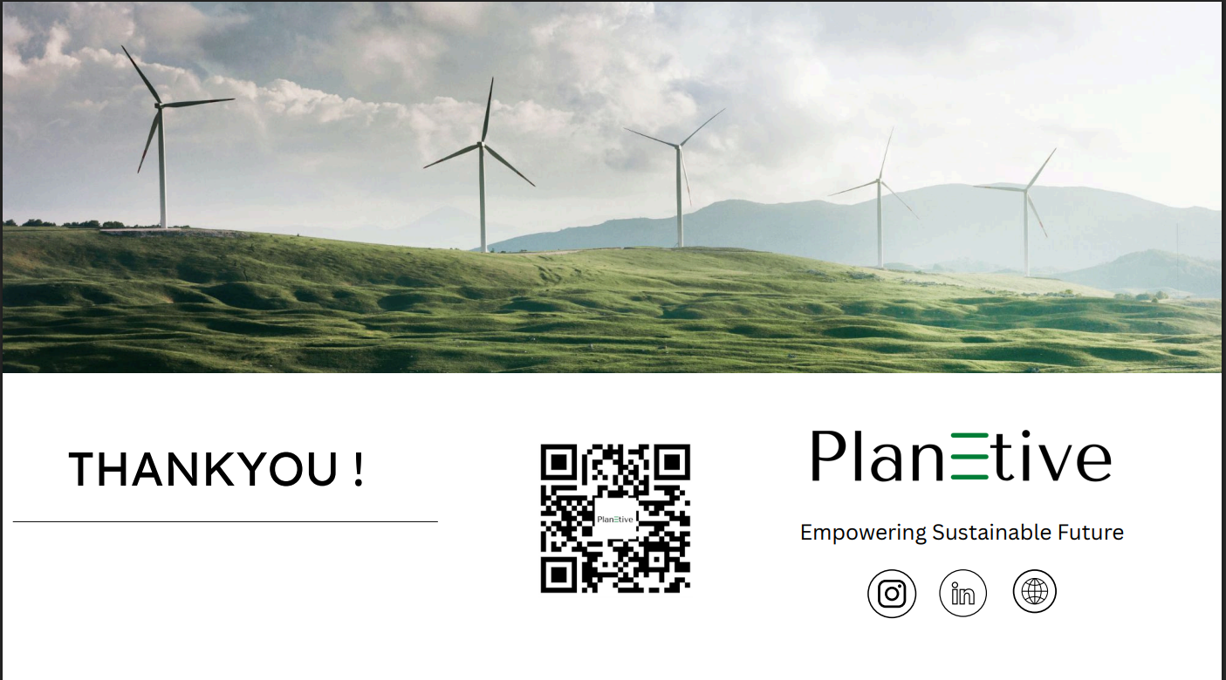

Two Sides of the Same Supply Chain: Bankable Mining and Bankable Refining
Reko Diq (Pakistan): Mining / Extraction Model
Lynas Malaysia (Kuantan) A Working Refining Hub
Feedstock
Processing
Customers
Governance
(15% paid, 10% carried) → social license & political durability
Barrick → technical & financial delivery
Concentrate from Mt Weld (Australia)
Industrial-scale separation into NdPr oxides)
Global magnet, EV, and electronics value chains
Operates under Malaysian regulation
Refining is where geopolitical leverage, price control, and supply disruption risk actually sit
Metric | Value
NdPr Capacity | 10,500 t/year
Heavy Rare Earth Separation | 1,500 t/year
NdPr Produced FY2025 | 6,558 t
% Global Refined Outside China | 8% (rest 92% China)
Malaysia’s Refined REE Share in US Imports | 13%
Recent Capital Raise | AUD$750M
New Expansion Investment | $180M
One of the world’s largest undeveloped copper-gold deposits
45Mtpa
90Mtpa
Future expansion of Ore
Planned output or Ore
Social License as Supply Security
Metric | Why It Matters
77% local employment | Reduces labor & shutdown risk
Water access (353 households) | Prevents community conflict
80% youth education access | Long-term workforce stability
$6.8m community investment | Lowers ESG discount rate
Refining hubs transform isolated mines into integrated, investable supply systems.
Over 85–90% of global rare earth separation and refining capacity remains concentrated in China
Mining diversification alone does not reduce supply risk without refining capacity
Refining is capital-intensive, technologically complex, and carries high ESG and permitting risk
Source & analysis: Planetive

Slide 6
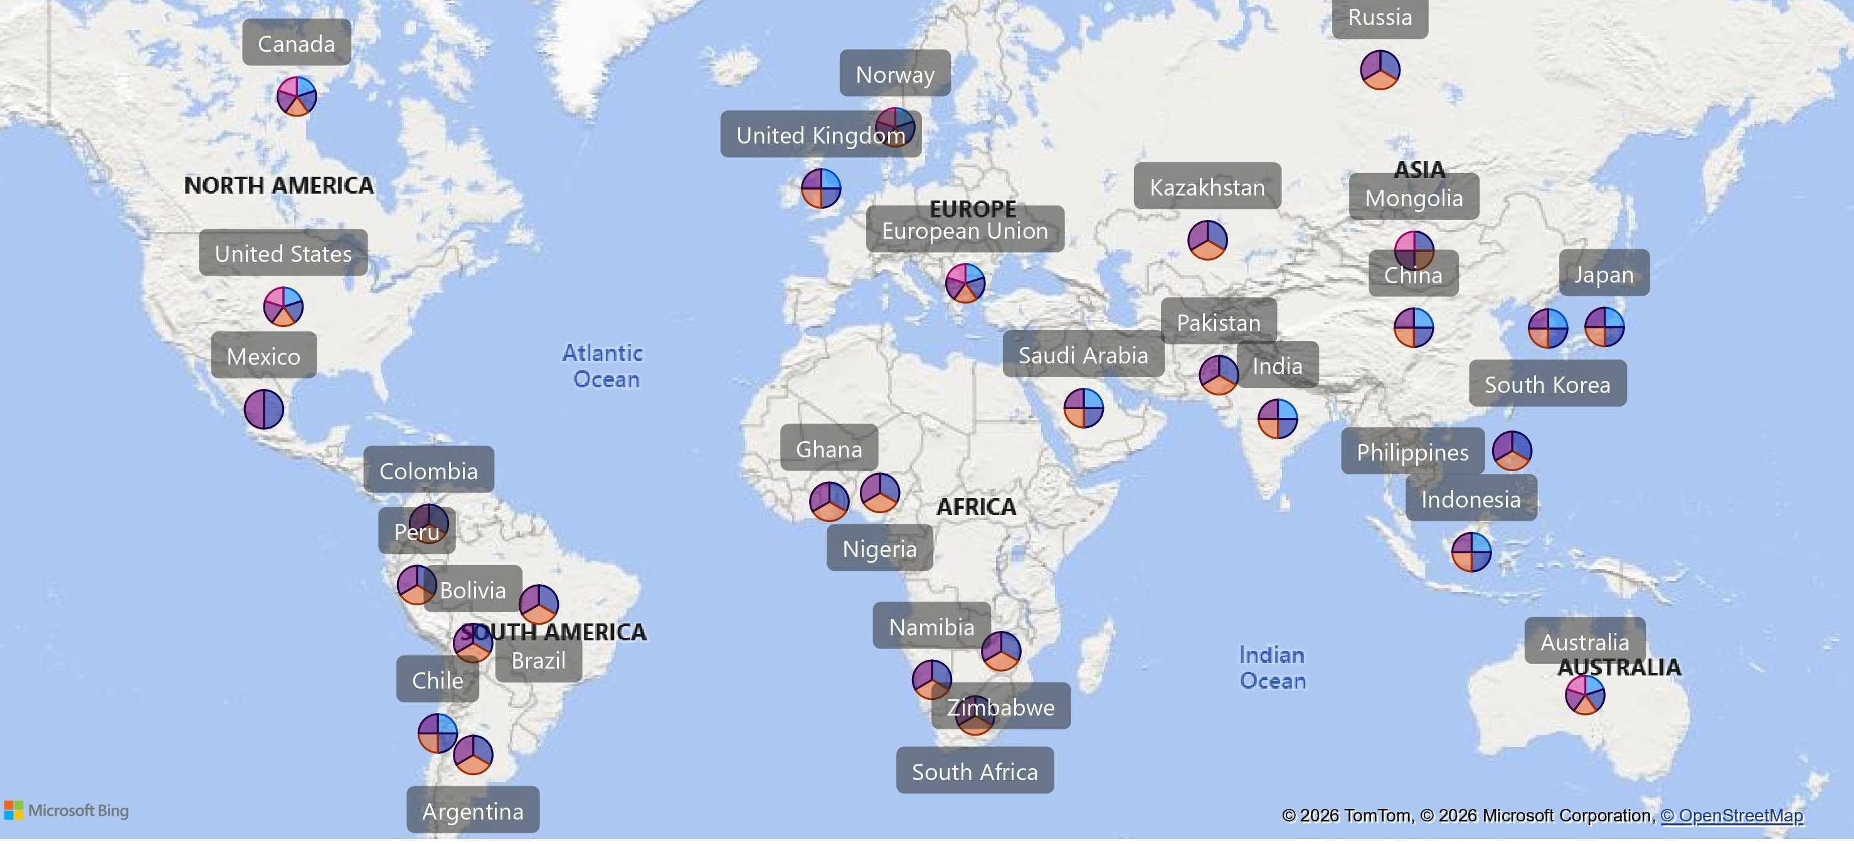
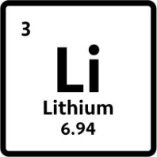
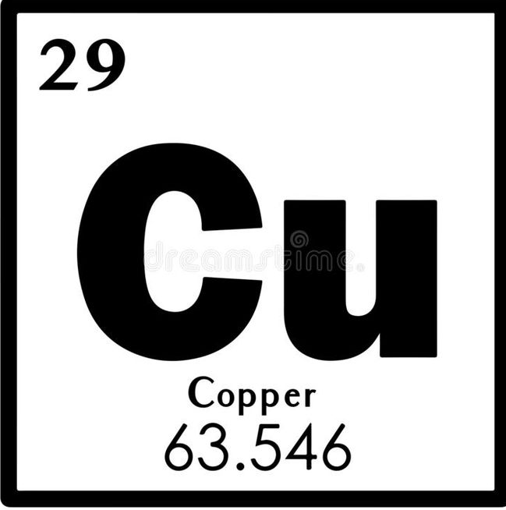
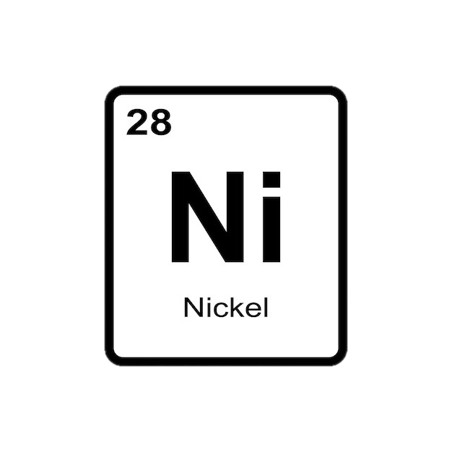
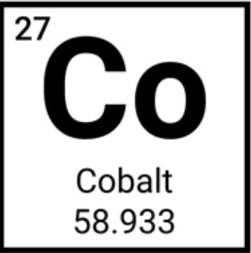
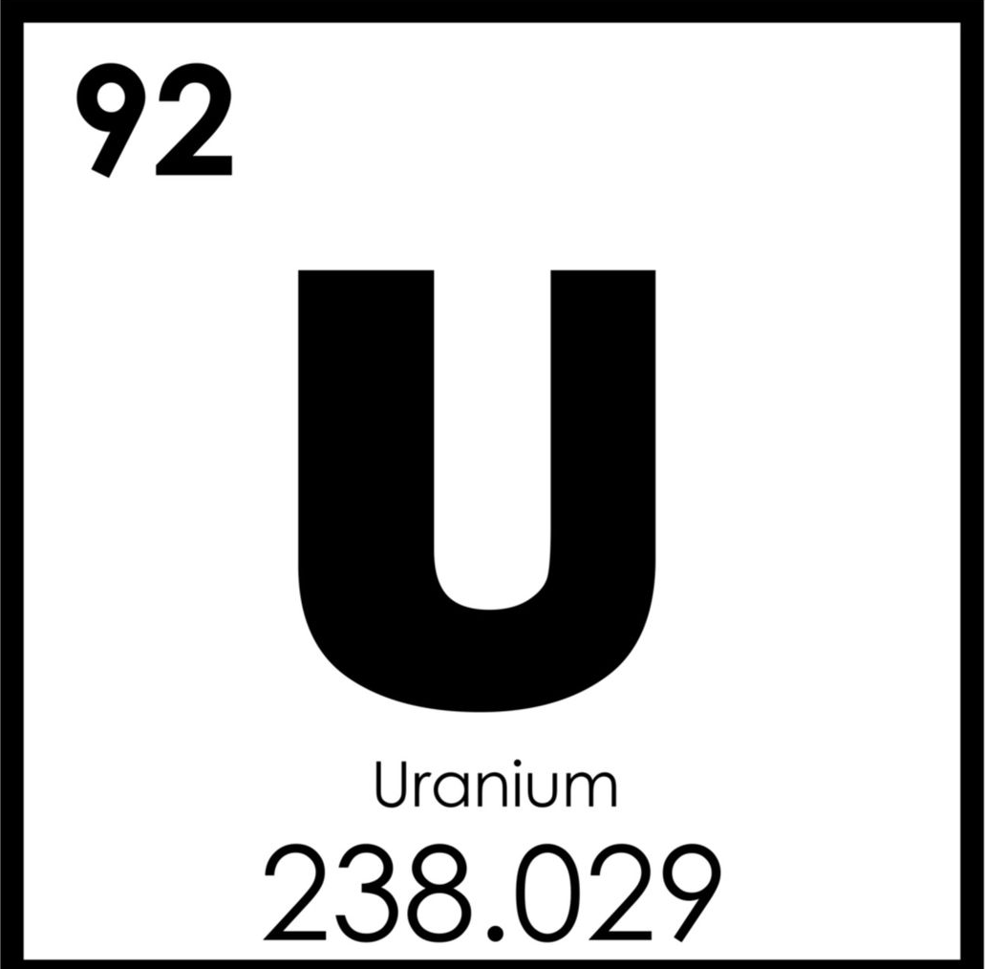
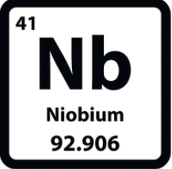













































































Geographic overview of policy coverage across the critical minerals value chain, from extraction to traceability
Mature Framework
(~10–25+ years)
Evolving Framework
(~5–15 years)
Emerging Framework
(>10 years)

Slide 7
Digital Infrastructure as a New Pillar of Critical Mineral Supply Security
Critical mineral resilience now depends on digital infrastructure that reduces uncertainty, enables certification, and makes supply chains financeable alongside physical assets.
Blockchain-Based Traceability as a Pre-Condition for Bankable Critical Mineral Supply Chains
Mining
Refining
Manufacturing
OEM
Financier/ Regulator
Global Battery Alliance (GBA) – Battery Passport
One shared digital passport (verifiable, auditable, portable)
AI as Digital Infrastructure for Resilient Critical Mineral Supply Chains
Geological uncertainty, long discovery timelines and high capital risk.
De Risking upstream supply at scope
KO Bold Metals (Copper & Battery Minerals)
More bankable projects
Faster upstream scaling
Diversified supply sources
AI makes new mineral supply possible, blockchain makes it transparent, and together they make it financeable.
Exploration & Mining
AI Driven Discovery
Processing & Refining
Digital Traceability
Market Access
(Risk Reduction )
(Trust & Compliance )
Bankable offtake
( Capital & Demand )

Slide 8
Digital Infrastructure as a New Pillar of Critical Mineral Supply Security
Critical mineral resilience now depends on digital infrastructure that reduces uncertainty, enables certification, and makes supply chains financeable alongside physical assets.
Downstream trust and compliance gaps
Financing & Bankability risk
AI
Exploration & Mining
Blockchain
Processing & Refining
Tokenization
Bankable offtake

Slide 9
Digital Infrastructure as a New Pillar of Critical Mineral Supply Security
KoBold Metals
(Copper & Battery Minerals)
Integrates Geological data, Geophysical surveys Satellite imagery
Upstream uncertainty
Downstream trust and compliance gaps
Global Battery Alliance – Battery Passport
Mine → Refining Hub → Manufacturing → OEM → Financier / Regulator
Shared Digital Passport (auditable, interoperable, trusted)
- Fragmented ESG and origin data – Regulatory misalignment across markets – Limited bankability of new refining hubs
– Low discovery success rates – Long lead times (8–15 years) – High geological and capital risk
Markets alone cannot solve this digital infrastructure is required.
More diversified upstream supply
Reduced capital loss from unsuccessful exploration
AI: REDUCING UPSTREAM SUPPLY RISK
BLOCKCHAIN: ENABLING TRUST & MARKET ACCESS
Exploration & Mining
AI Driven Discovery
Processing & Refining
Digital Traceability
Market Access
(Risk Reduction )
(Trust & Compliance )
Bankable offtake
( Capital & Demand )
AI reduces uncertainty. Blockchain creates transparency. Together, they unlock bankability.

Slide 10
Digital Infrastructure as a New Pillar of Critical Mineral Supply Security
AI – Supply Intelligence
Tokenization – Capital mobilization
Blockchain – traceability Infrastructure
De Risking upstream supply at scope
KO Bold Metals (Copper & Battery Minerals
London Metal Exchange (LME) — Digital Warehouse Receipts
AI + geological science → predictive discovery models
Digital inventory as collateral for trade & project finance
Nickel
Copper
Zinc
Aluminum
Global Battery Alliance (GBA) – Battery Passport)
Financeable Critical Minerals Ecosystem
Proven & Emerging Tokenization Examples in Critical Minerals
Mining
Refining
Manufacturing
OEM
Financier/ Regulator
Initiative / Platform | Mineral(s) Backed | Physical Backing Mechanism | Region / Base | Policy Relevancy
CopperToken (BCubed) | Copper | 1:1 copper inventory in bonded warehouses | Switzerland | Tokenized inventory used for industrial trade finance
Paxos Gold (PAXG) | Gold (reference model) | LBMA-certified vaulted gold | Global (issuer regulated) | Gold standard for custody, audit, redemption frameworks
Xinjiang / Shanghai Metals E-Receipts | Copper, Aluminium |  | China | Government-backed digitized commodity ownership
Abaxx Exchange (in development) | Battery metals (Nickel, LNG-linked model) | Exchange-cleared physical contracts | Singapore | Exchange-native digital settlement infrastructure
Brazilian CPR / Warehouse Receipt Digitization | Iron ore, base metals | Digitized receivables & inventory | Brazil | Tokenized commodity finance in emerging markets
One shared digital passport (verifiable, auditable, portable)
From Physical Molecules → Bankable Digital Assets
Ore → Metal → Warehouse → Digital Asset → Capital
AI expands supply
Blockchain validates trust and transparency
Tokenization makes critical minerals financeable at scale.
Exploration & Mining
AI Driven Discovery
Processing & Refining
Tokenized inventories/ Digital warehouse Assets
Market Access
(Supply Risk Reduction )
(Liquidity & Financial Risk reduction)
Traceable & verified supply
( Traceability & Compliance risk reduction)

Slide 11



Global Critical Mineral Supply Chains
BANKABLE INVESTMENT MODEL FOR CRITICAL MINERALS
Blended Finance + Long-Term Offtake (Producer–Consumer Anchored)
Long-term offtake agreements
Public or quasi-public capital
Private Capital
Revenue Certainty
Risk Absorption
Market Certainty
Risk Allocation = Increased FID
Global examples showcasing success
Vulcan Energy (Germany)
Long term offtake with Stellantis
Export credit & public finance support
Private debt and equity
→ Enabled multi-billion-euro European lithium project
Caremag (France–Japan)
€110m Japanese investment
Long-term offtake securing heavy rare earth separation
→ Enabled rare earth processing capacity outside China

Slide 12
From Demand to Deliverability: The Real Constraint in Critical Mineral
By 2030–2040, critical mineral demand is projected to exceed existing supply by 20% to over 150%, depending on the material.
Without local or allied refining capacity, even well-governed mines fail to translate into energy security
Capital and demand exist — energy transition investment is not the bottleneck
Supply is constrained by deliverability: permitting, refining capacity, geopolitics, and social license.
Without governance-aligned Frameworks, shortages become structural

Slide 13
Digital Infrastructure as a New Pillar of Critical Mineral Supply Security
Critical mineral resilience now depends on digital infrastructure that reduces uncertainty, enables certification, and makes supply chains financeable alongside physical assets.
AI as Digital Infrastructure for Resilient Critical Mineral Supply Chains
Geological uncertainty, long discovery timelines and high capital risk.
De Risking upstream supply at scope
KO Bold Metals (Copper & Battery Minerals)
More bankable projects
Faster upstream scaling
Diversified supply sources
Blockchain-Based Traceability as a Pre-Condition for Bankable Critical Mineral Supply Chains
Mining
Refining
Manufacturing
OEM
Financier/ Regulator
Global Battery Alliance (GBA) – Battery Passport
One shared digital passport (verifiable, auditable, portable)
Exploration & Mining
AI Driven Discovery
Processing & Refining
Digital Traceability
Market Access
(Risk Reduction )
(Trust & Compliance )
Bankable offtake
( Capital & Demand )

Slide 14
Global Critical Mineral Supply Chains
BANKABLE INVESTMENT MODEL FOR CRITICAL MINERALS
Exploration & Mining
Refining & Separation
Concentration & Beneficiation
Battery material Production/ Alloying
Manufacturing
Recycling & Circular loops
New mining and processing projects require 7–10+ years to reach production
Blended Finance + Long-Term Offtake (Producer–Consumer Anchored)
Upstream Weakness = Downstream vulnerability
Long lead times, Geopolitical barriers
Long-term offtake agreements
Public or quasi-public capital
Private Capital
ESG issues, radioactive tailings, financing challenges
China Dominance, Limited Global refining
China refines 90% of rare earths and 60–95% of key battery materials highlighting extreme midstream concentration
Revenue Certainty
Risk Absorption
Market Certainty
Technology bottlenecks, Cost volatility
Risk Allocation = Increased FID
Global examples showcasing success
Demand Supply Imbalances
Vulcan Energy (Germany)
Long term offtake with Stellantis
Export credit & public finance support
Private debt and equity
→ Enabled multi-billion-euro European lithium project
Caremag (France–Japan)
€110m Japanese investment
Long-term offtake securing heavy rare earth separation
→ Enabled rare earth processing capacity outside China
Markets are necessary, but not sufficient, to resolve supply–demand fundamentals

