Slide 1

Post-COVID Recovery Energy Monitor
Alternative Metrics for Real-Time Assessment of Energy Demand
International Energy Forum | 19 April 2021

Slide 2
Key Messages
IEF combined data from JODI and trackers (mobility, COVID-19 government response, vaccinations) to assess transport fuel demand’s recovery.
Gasoline and diesel demand rebounded to ~93% of pre-COVID levels in March 2021 from ~87% in January 2021.
Where? ~35% of volume gains driven by US and India. Many European countries’ mobility lag 20-40% below the January 2020 baseline. In China, serious pick-up, while passenger traffic declined 45% last year.
5.2 mb/d still missing: Jet fuel to remain 5.5-5.7 mb/d during 1H2021, vs 7.9 mb/d in 2019. Road transportation fuels demand could reach pre-COVID levels in 2022 on aggregate.
Continue monitoring non-traditional metrics during the remainder of 2021, Ramadan, summer vacation travel patterns, and wider economic recovery.

Slide 3
JODI: Gasoline & Diesel Demand in January Near 87% of 2019 Levels vs. 71% in April 2020

Slide 4
Demand Recovery Remains Asynchronous: India Rebounded Significantly While Germany Hits New Lows

Slide 5
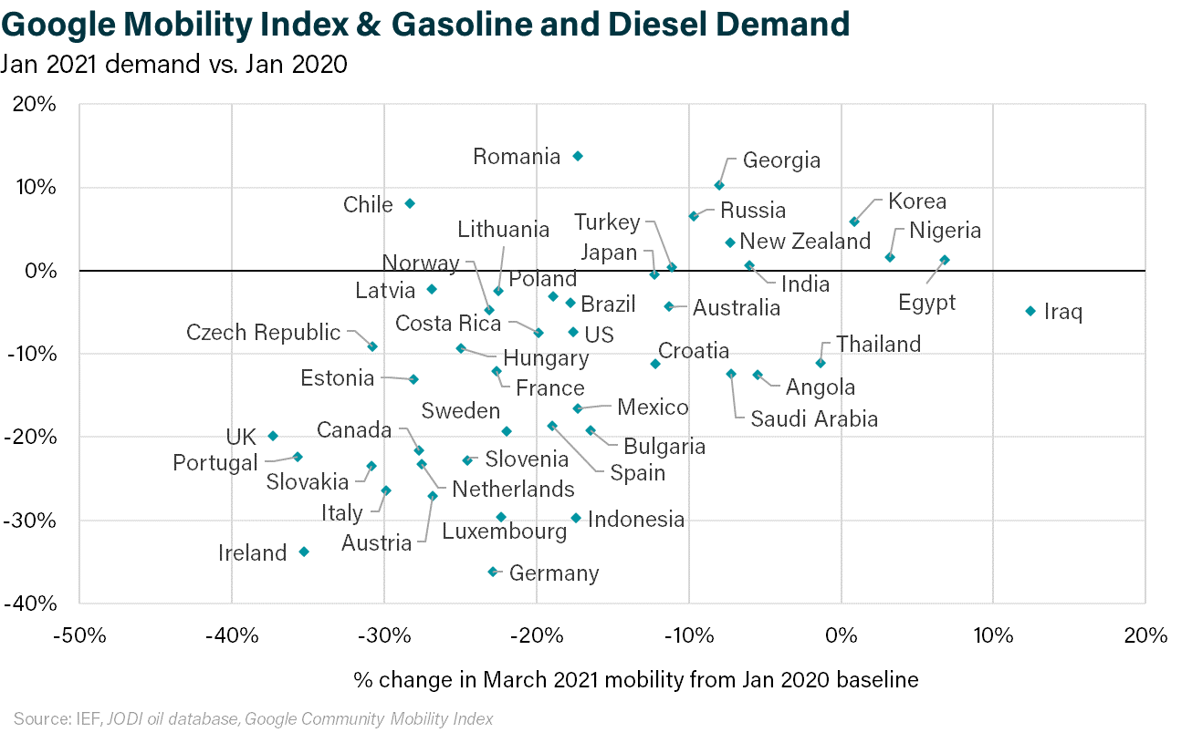
European Mobility Remains Down 20-40% While Asia, Oceania, & MENA Show Faster Recovery

Slide 6
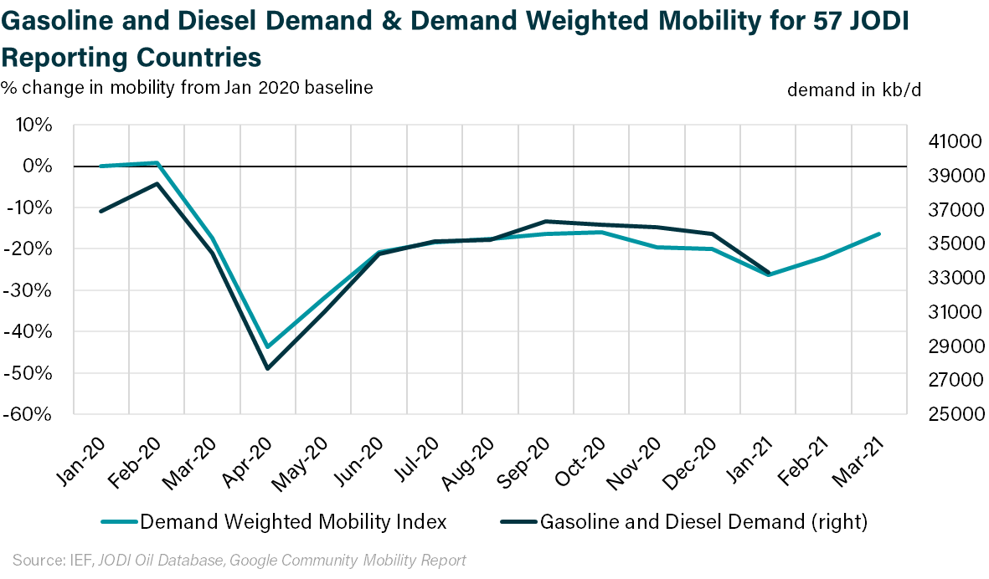
Strong Correlation Between Mobility and Gasoline and Diesel Demand Implies >2 mb/d Demand increase 1Q2021

Slide 7
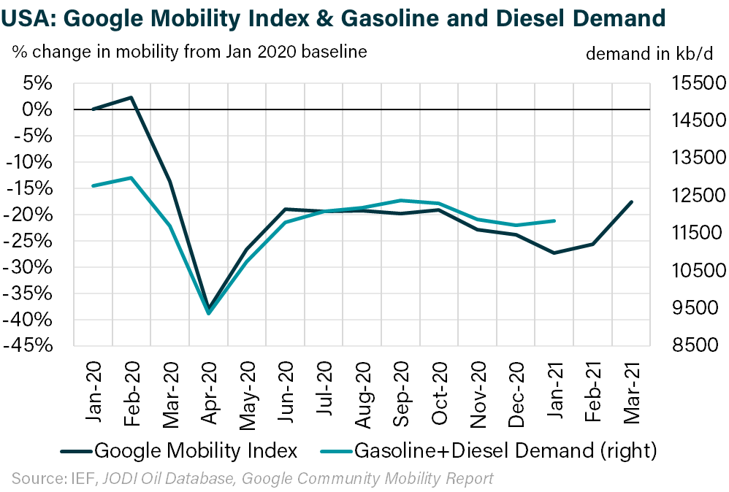

March US Mobility Implies >500 kb/d M/M Gasoline & Diesel Demand Jump (Consistent With EIA)

Slide 8

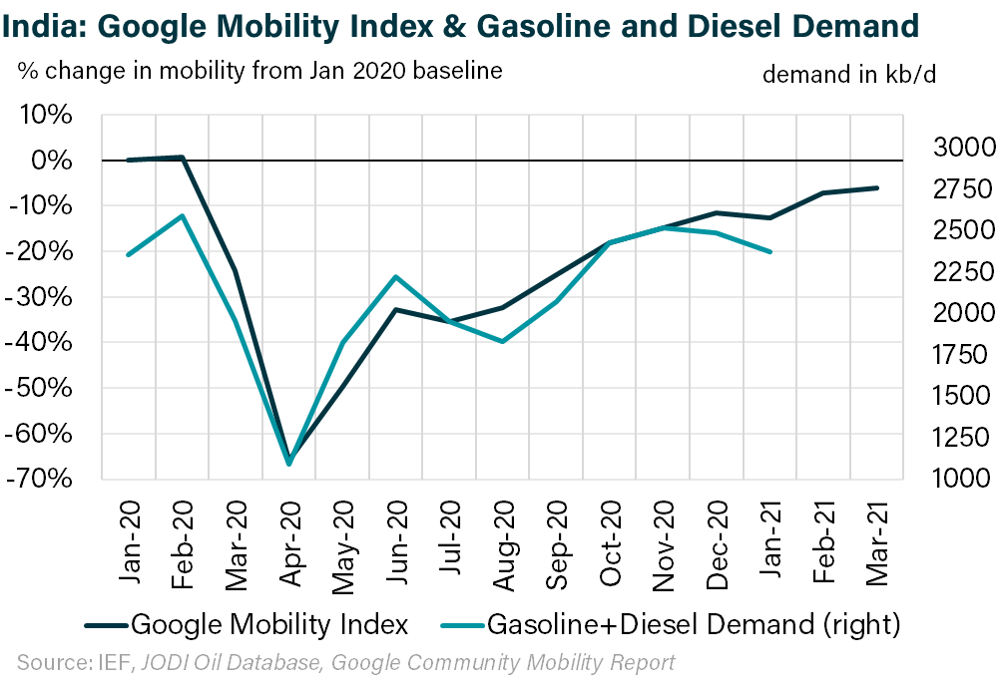
India’s Gasoline & Diesel Demand at 97% of Pre-COVID Levels in January and Mobility Continues to Rise

Slide 9

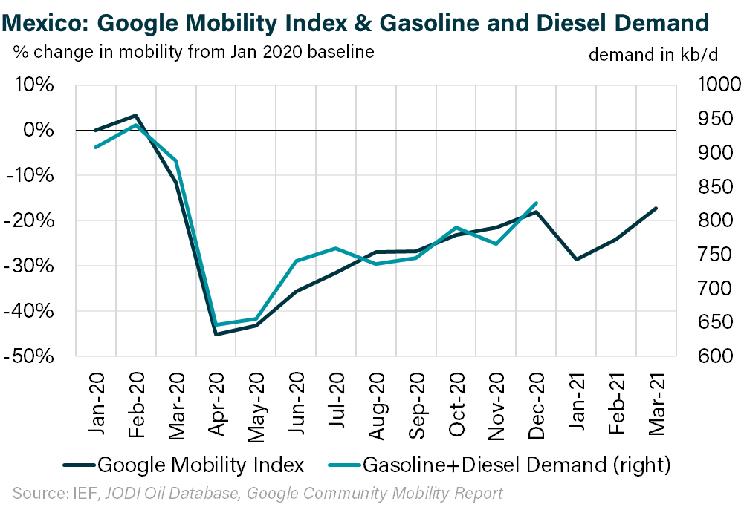
Mexico’s Mobility Climbed to COVID High in March, But Gasoline & Diesel Demand Likely Remain Down ~20%

Slide 10

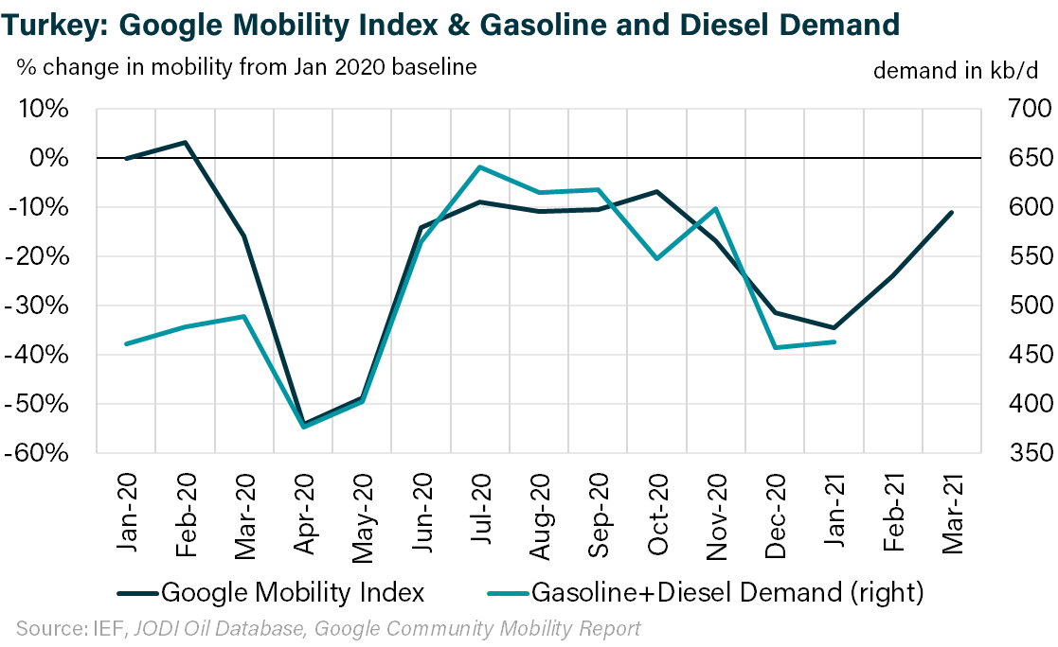
Rising Mobility in Turkey in February and March Implies Demand Turnaround After 4Q20 Declines

Slide 11

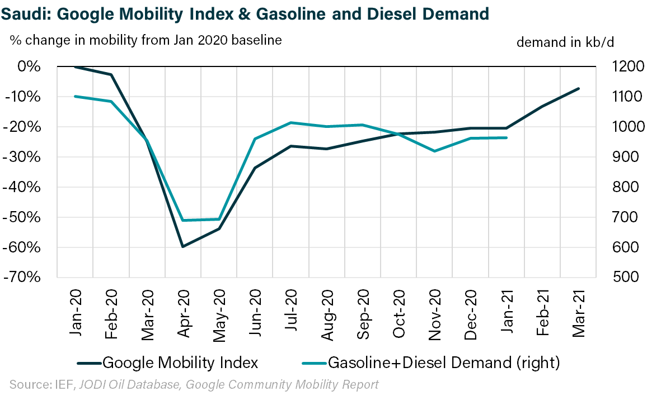
Mobility in Saudi Arabia Rose By >10% in 1Q21, Implying >100 kb/d Pick-Up in Gasoline and Diesel Demand

Slide 12

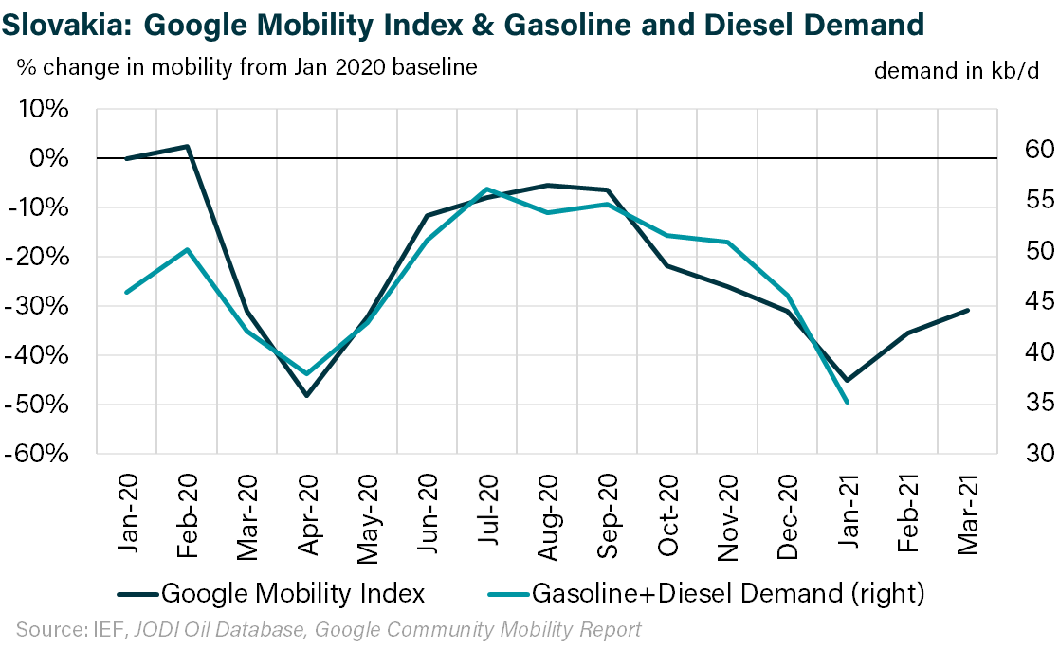
Slovakia Mobility is Recovering From January’s Slump, But Remains ~30% Below Baseline Levels

Slide 13
China Lacks (Public) Mobility Data, But Policy Stringency Declined >20 pts Since Late-Feb

Slide 14
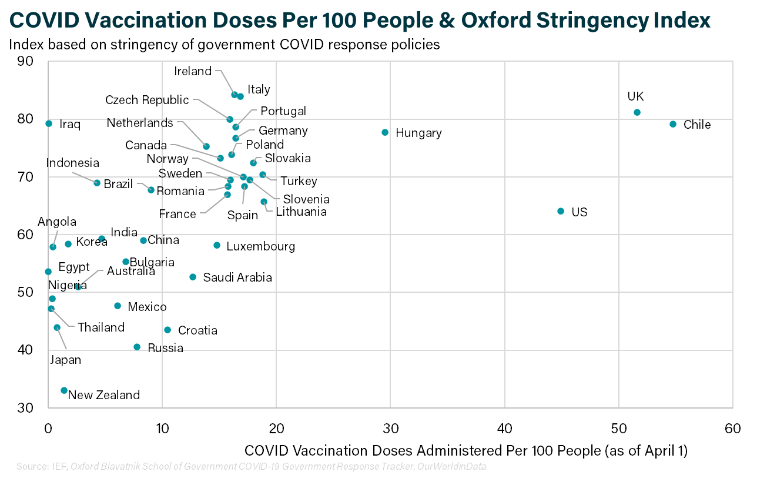
Vaccinations are a Weaker Metric: Higher Vaccination Rates ≠ Relaxed Government Restrictions or Stronger Mobility

Slide 15
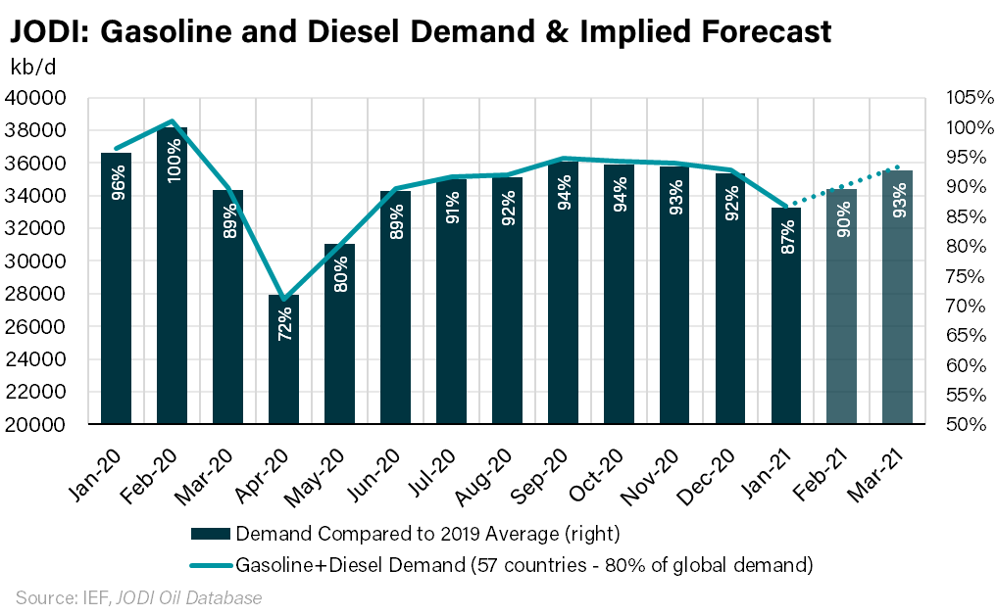
JODI+ Alternative Metrics: Gasoline & Diesel Demand in March Near 93% of 2019 Levels

Slide 16
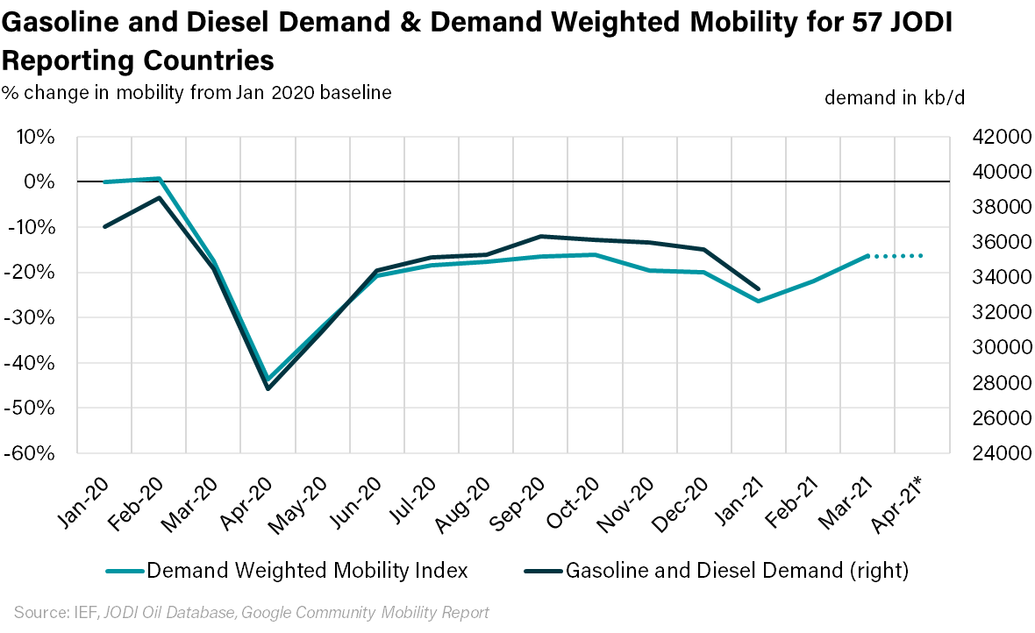
Mobility Data for First Two Weeks of April Imply Stagnation in Transportation Fuel Demand Recovery

Slide 17
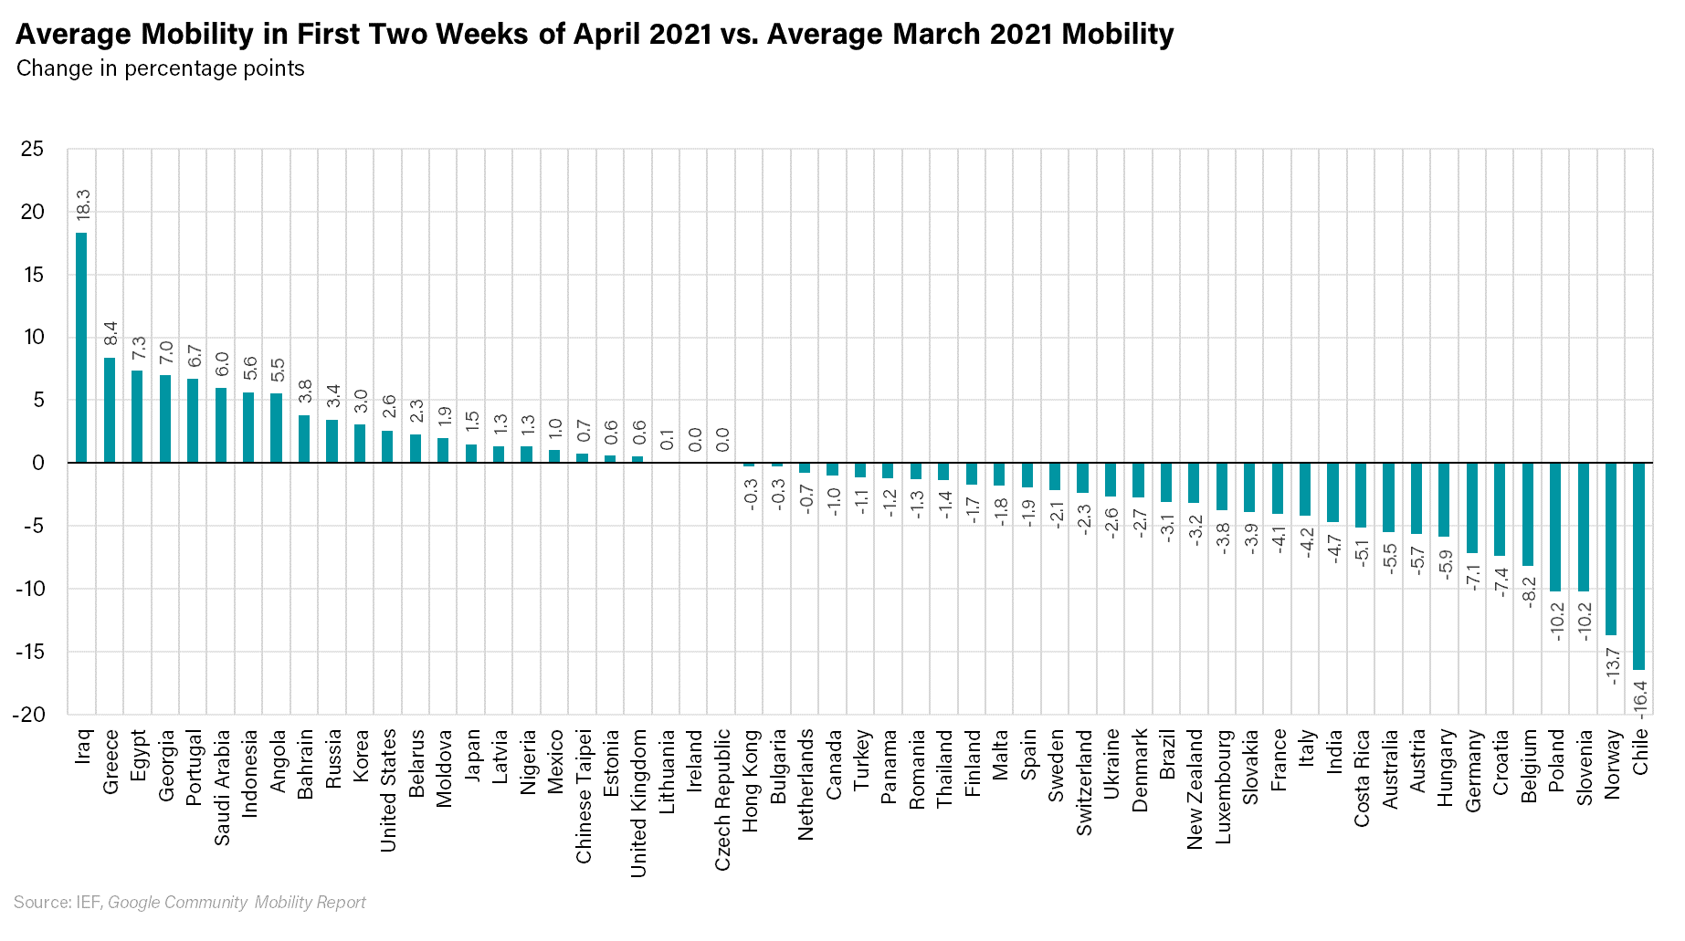
Mobility Has Fallen Across Parts of Europe, India and Chile in Recent Weeks, But Picked Up in Regions Including MENA, US, and Russia

Slide 18
The Global Home of Energy Dialogue
ief.org
Amr Aldamri Street, Circle 6, Diplomatic Quarter, Riyadh, 11614
+966 11 4810022 Leila.Benali@ief.org

